Slide 1
Introducing Decision Doc, powered by Sherpa

Slide 2
The Problem:
When individuals choose the wrong benefits, everyone loses.
53% of employees say they are confused about what health insurance they need.
Consumers lose money on high health insurance premiums and leave themselves inadequately protected in case of an unforeseen emergency.
Employers lose money on premiums and lack the insight and resources to help employees improve their financial wellness.
43% of employees don’t have enough life insurance.
86% of employers are prioritizing benefit affordability for their employees.

Slide 3
The Solution:
A comprehensive Medical-through-Voluntary Decision Support tool
Employees go through a set of questions about their health needs, financials, and insurance coverage.
Along the way, access education and resources
They receive a Protection Score showing how well protected they in case of an emergency – along with education on how they can improve their financial resilience.
Explore different benefits impact their overall Protection Score
Employees receive an interactive report showing which health plan will cover them best and prioritized recommendations of which voluntary benefits to choose.
Add or remove services and see real-time impact on costs
They then click to navigate to the enrollment platform and confidently choose their health plan and voluntary benefits.
Easily access live analysts with questions about report
Custom messaging available at every step.
~$1,300 savings per employee
~$1,300 savings per employee

Slide 4
Our Impact Difference
Simple set up:
Decision Doc tests and loads all data
Custom communications package with emails, posters, videos, and slides. All collateral can be custom branded.
Per-client customizations
Easy to use:
Single solution covers health care and voluntary benefits
Takes 8-10 minutes to complete
Custom messaging available at every step
Proof of impact:
Clients receive retrospective report showing benefits utilization
Clear picture of employee financial wellness and needs
Demonstrates ROI on benefits spending
93% employee satisfaction
3x increase in employee migration
8x increase in insurance purchase

Slide 5
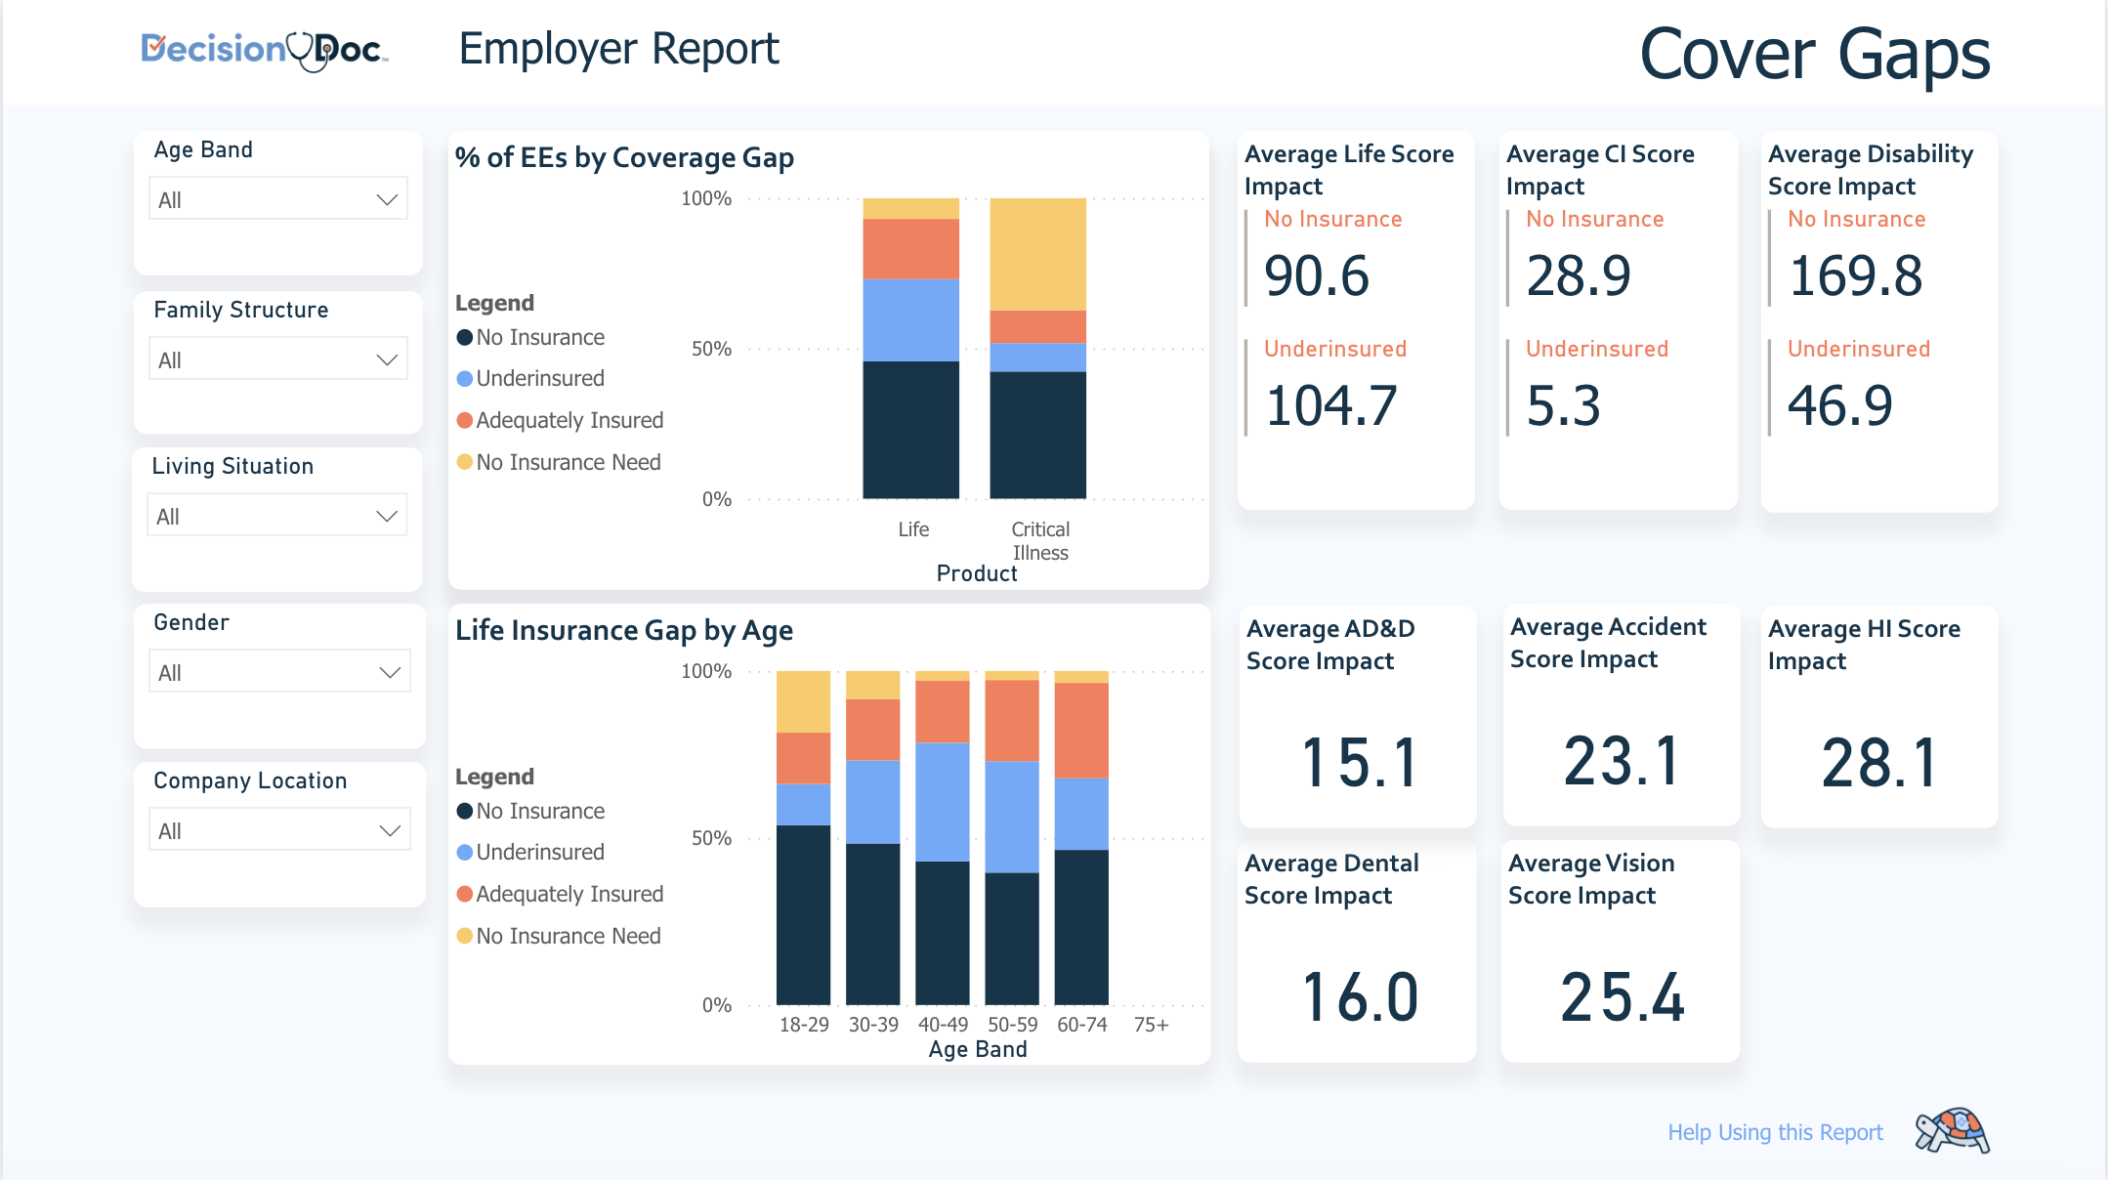
The Employer Dashboard
Retrospective reporting post-enrollment
Our ER Dashboard helps employers/consultants tailor and optimize benefits programs.
Understand true picture of employee financial wellness and vulnerabilities – and what voluntary benefits can help the most.
Identify health plan design that captures maximal employee and employer saving.
Understand ROI on benefits spending.

Slide 6
What makes Decision Doc different?
Easy install: Implementation is simple with minimal asks of the employer. Brokers send us plan docs and contribution structure; we do the rest!
Custom communications plan: MHM creates a custom communications plan for every client (custom language, slides, and branding)
Leveraging the Score mechanism: The Score becomes a unique capability that motivates behavioral change and allows employees to visualize the gaps in their protection, and how to solve for them
Notes:
Employee Experience:
Decision Doc embeds education throughout the online experience to help the employee feel more confident when making benefit selections
Decision Doc provides ample hands-on, person-to-person support, meeting employees where they’re most comfortable (our call center can accommodate 200+ languages)
Decision Doc’s attention to the medical plans, often both the employee’s and employer’s biggest expense, is unparalleled, allowing for incredibly precise insight into what elections make the most sense for the employee.
Voluntary benefits are considered in tandem with the medical plans and no longer considered as an after-thought.
Install Process:
Decision Doc, by design, is incredibly low-lift for partners. It does not require integration or large lifts from benefits teams or technology teams.
Employers are provided a custom communications package that they can seamlessly integrate into their broader benefits communication materials.
It takes ~4 weeks to get everything implemented.
Decision Doc is available outside open enrollment, supporting employees through qualifying life events and any new hires. Updated material will be shared once open enrollment is complete.
Cost Calculation Accuracy:
Brokers share health plan documents, contribution strategies, and other benefit information with the Decision Doc team. Employers share a census file.
Employees answer questions about their specific needs and situation.
On the report, Decision Doc walks employees through their options and provides context, education, and incredible transparency into the calculations.
Employees can create different scenarios and see the real time impact of their different usage on the guidance Decision Doc shares.
Impact:
Decision Doc can provide insight into plan migration and trends from open enrollment.
Through increased data collection, Decision Doc can give employers a sense of their workforce’s financial resilience such as who’s being left behind, where they’ve got financial stresses, what their employees’ strengths are, etc.
With this radical amount of insight into their employee population, employers can begin to tailor their total benefits package to better support their employees.

Slide 7
Thank you

