Slide 1
Personalized Decision Support
Decision Doc helps you choose the right benefit package for you and your family.

Slide 2
Why Use Decision Doc, powered by Sherpa Score:
~$1,300 savings on health care costs, per employee
5 - 6 minutes to complete
Customized protection score and interactive report!
Notes:
Decision Doc, powered by Sherpa Score is free and available to all benefit eligible employees. This confidential platform takes just 5-6 minutes to complete and can help you learn which benefits will work best for you. Many employees don’t select the right benefits, or don’t know where to start when choosing their plans. Folks who use Decision Doc save an average of $1,300 on health care costs! Get started at www.myhealthmath.com/cloudflare2023 to get help today.

Slide 3
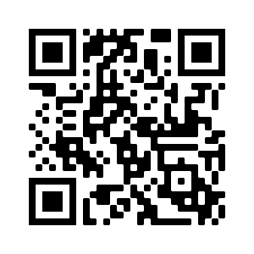
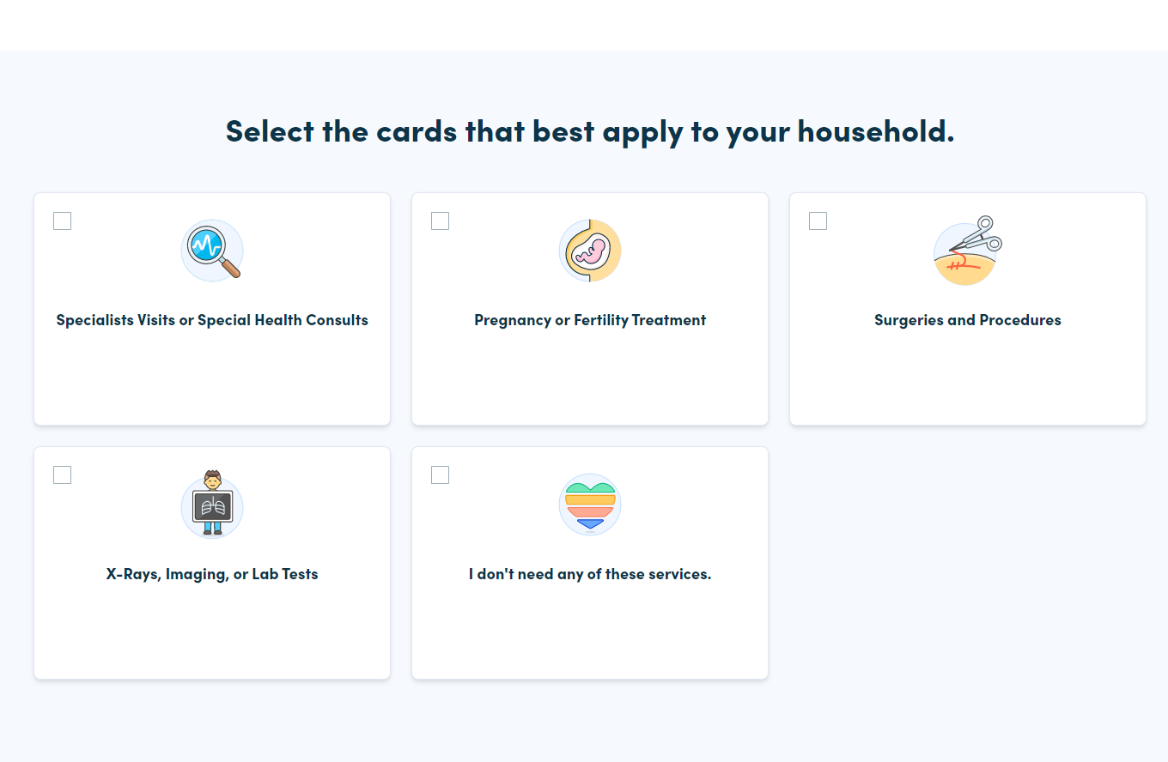
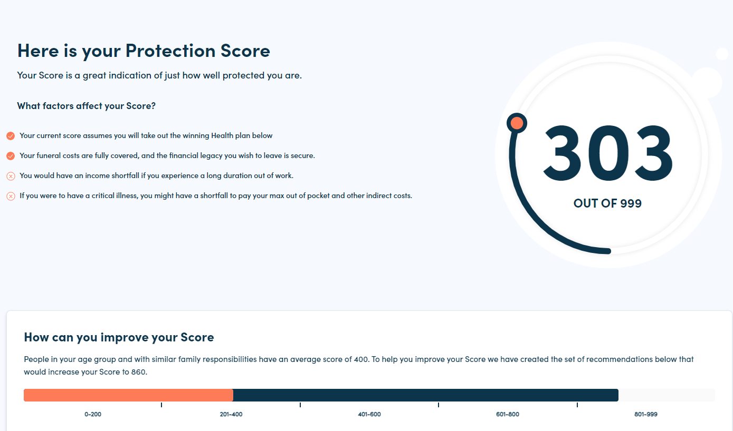
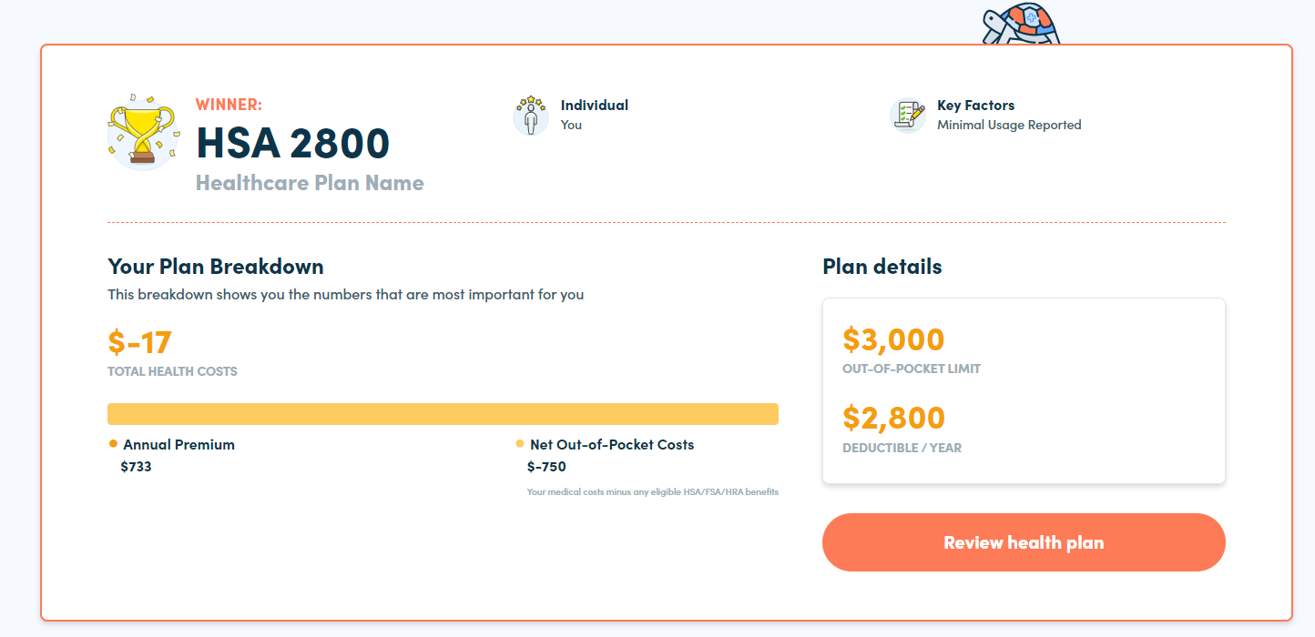
How It Works
Access Decision Doc here: www.myhealthmath.com/cloudflare2023
1
Answer questions about your health care needs, finances and family in ~5 minutes
2
Receive an instant Protection Score with personalized resources and guidance
3
Review your report, winning health plan breakdown, enroll & save!
Notes:
First, you’ll answer some questions online about your health care needs, finances and family situation. These will take you about 5-6 minutes to complete.
Then, you will receive an instant Protection Score. Your Protection Score will help you select a benefit package that will best meet your needs for the upcoming year. This report will show you how each of the benefits offered by Cloudflare can help you improve your score.
Make sure you save or print your report, so you can make an informed enrollment decision this year!

