Slide 1
Personalized Decision Support
Decision Doc helps you choose the right health plan for you and your family.

Slide 2
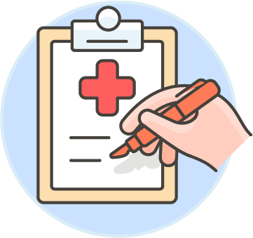
Why Use Decision Doc:
~$1,300 savings per employee
5-10 minutes to complete
All information is secure and confidential
Notes:
As an added benefit to you, we’re pleased to share that Decision Doc, powered by MyHealthMath, is available to all employees. MyHealthMath is a completely neutral third party and their interactive platform can help you learn about our health plan options before making your enrollment decision.
This is a free, quick, and easy confidential service that we encourage everyone to use. It can provide peace of mind for those of you that already know which plan you want to select. Alternatively, if you aren’t sure which plan you’re going to choose, Decision Doc can help you decide!

Slide 3
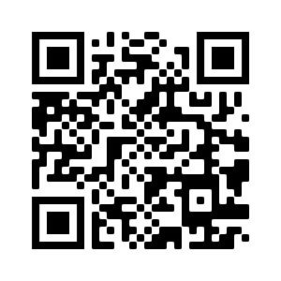
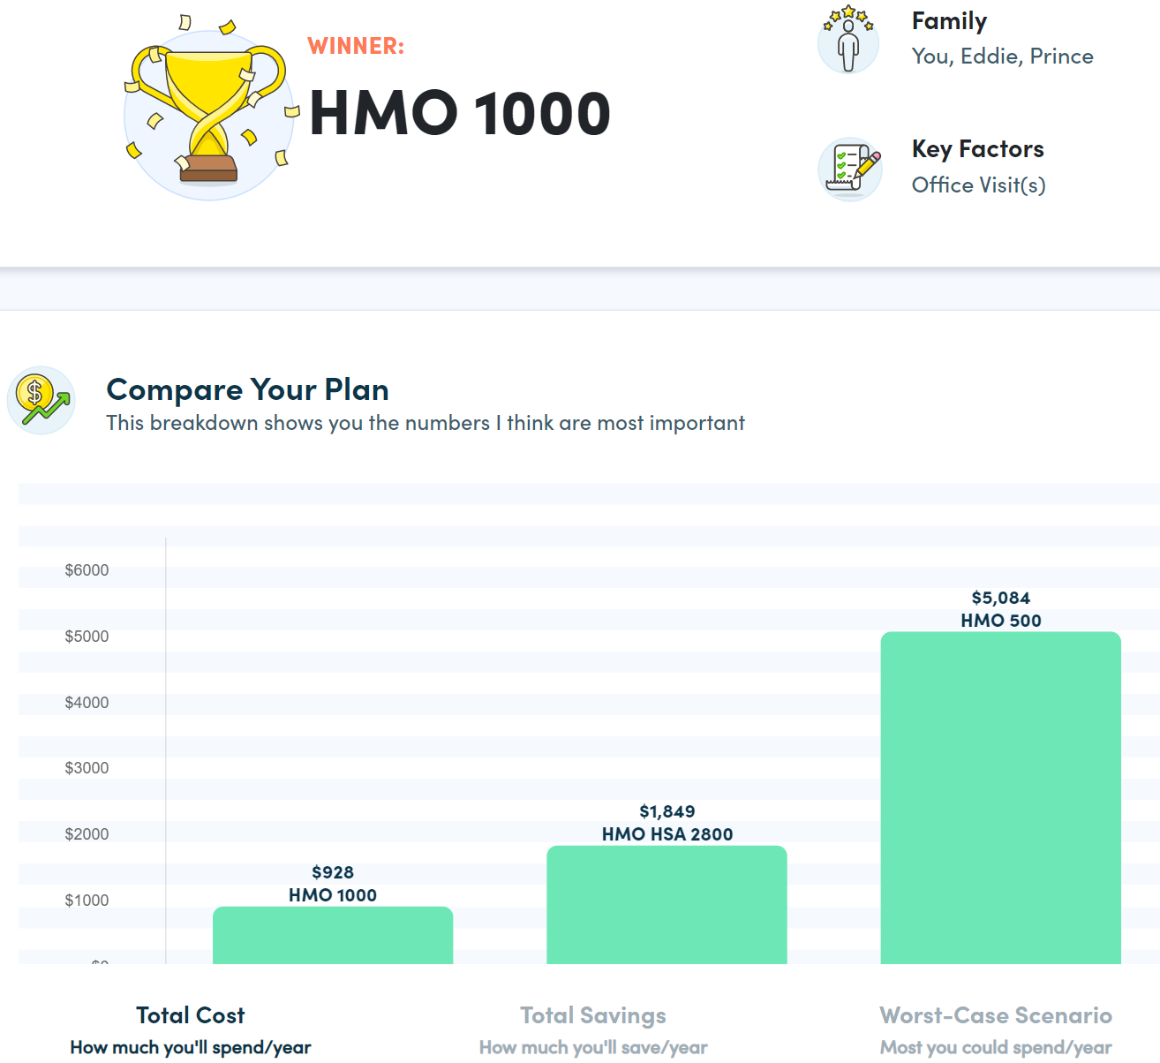
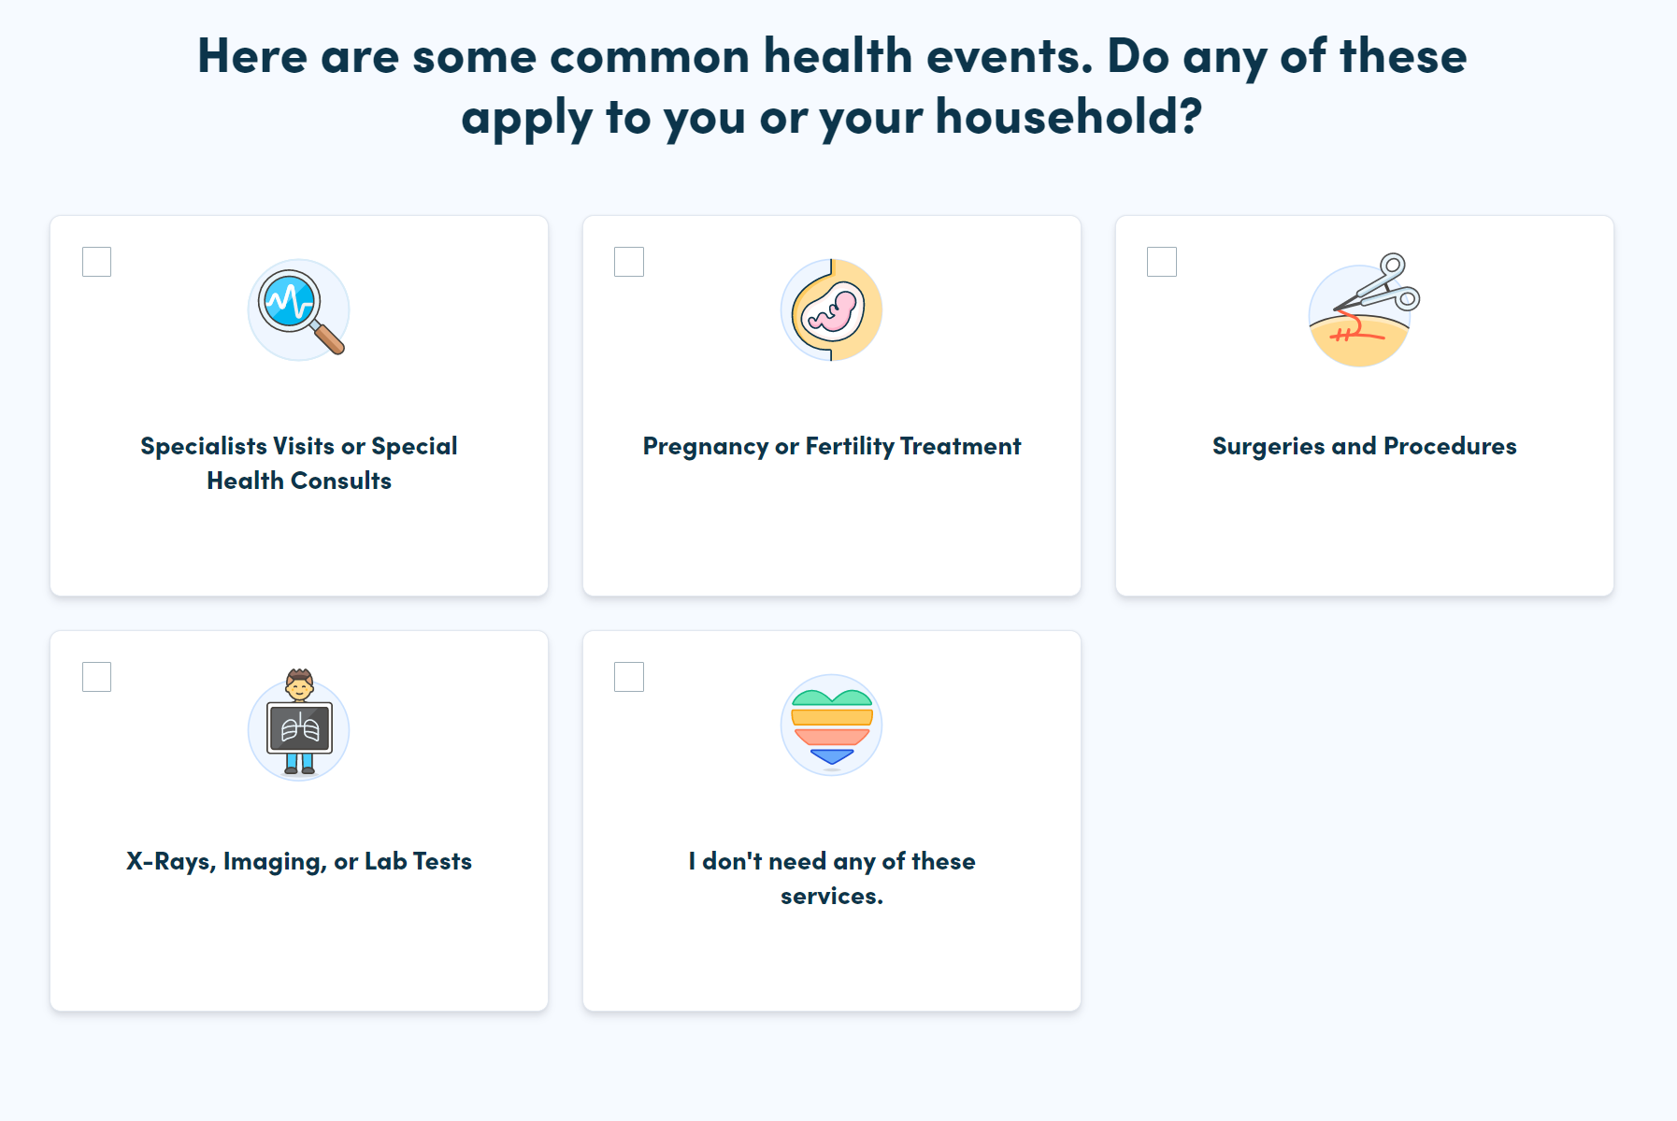
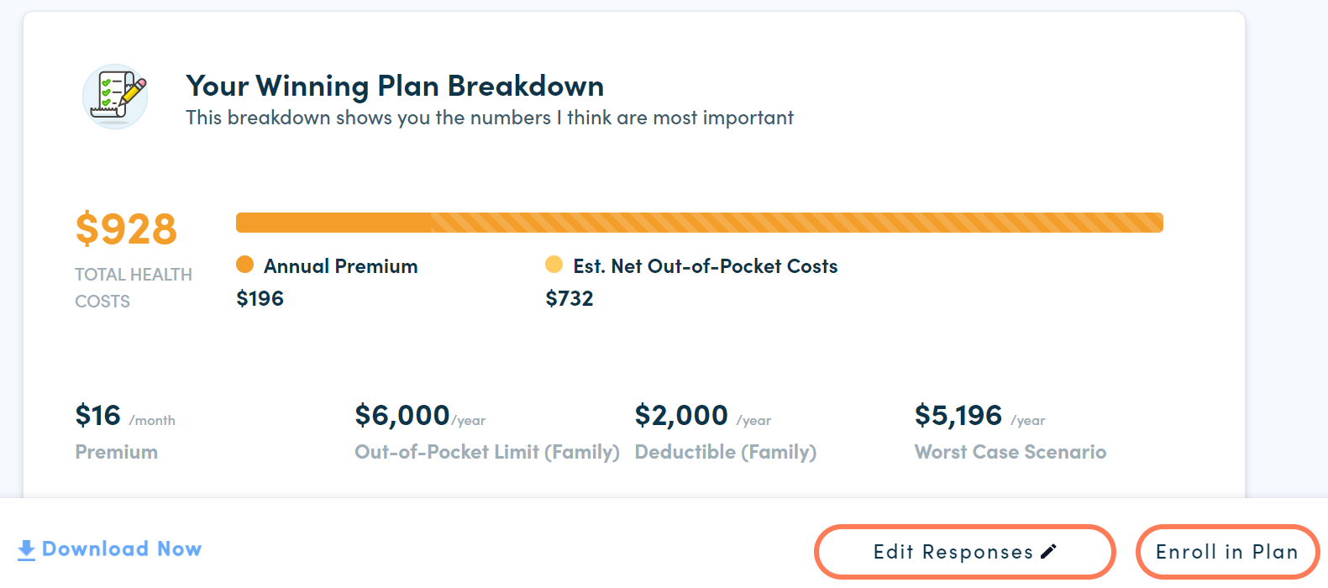
How It Works
Access Decision Doc here: www.myhealthmath.com/ferrellgas2023
Share your medical and pharmacy needs in ~5 minutes
Agents available to go through the questions on the phone!
Receive immediate recommendations on optimal plan
Contact support with any questions!
Enroll & Save
Average employee user saves $1,300/year
1
2
3
Notes:
Decision Doc can be accessed using the link above, or by scanning the QR code.
You’ll start by answering some medical questions, either online or by scheduling a phone call. Questions range from the types of specialists you and your family members may see, to surgeries you may be thinking of, to the types of prescriptions anyone may be taking. This level of detail is important so Decision Doc can calculate which plan option will best meet your specific medical needs.
If you answer these questions online, you’ll receive an immediate recommendation on which plan will be the best fit, based on cost, for you and your family. Your report will include details on how Decision Doc determines your winning plan, as well as provide a bunch of resources to help you make your decision.
If you do decide to go through the questions over the phone with a MyHealthMath agent, you will receive your report via email within 1 – 2 business days.
At any time, we encourage you to connect with MyHealthMath if you have any questions about how to use Decision Doc or how to understand your report. They can be reached via questions@myhealthmath.com.

Slide 4
Longer version

Slide 5
Personalized Decision Support
Decision Doc helps you choose the right health plan for you and your family.

Slide 6
Why Use Decision Doc:
~$1,300 savings per employee
5-10 minutes to complete
All information is secure and confidential
Notes:
This year, we’re pleased to share that Decision Doc, powered by MyHealthMath, is available to all employees. MyHealthMath is a completely neutral third party and their interactive platform can help you learn about our health plan options before making your enrollment decision.
This is a free, quick, and easy confidential service that we encourage everyone to use. It can provide peace of mind for those of you that already know which plan you want to select. Alternatively, if you aren’t sure which plan you’re going to choose, Decision Doc can help you decide!

Slide 7
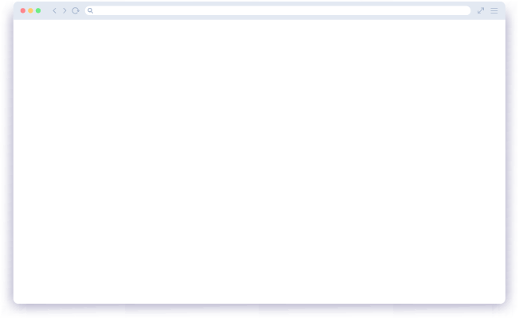
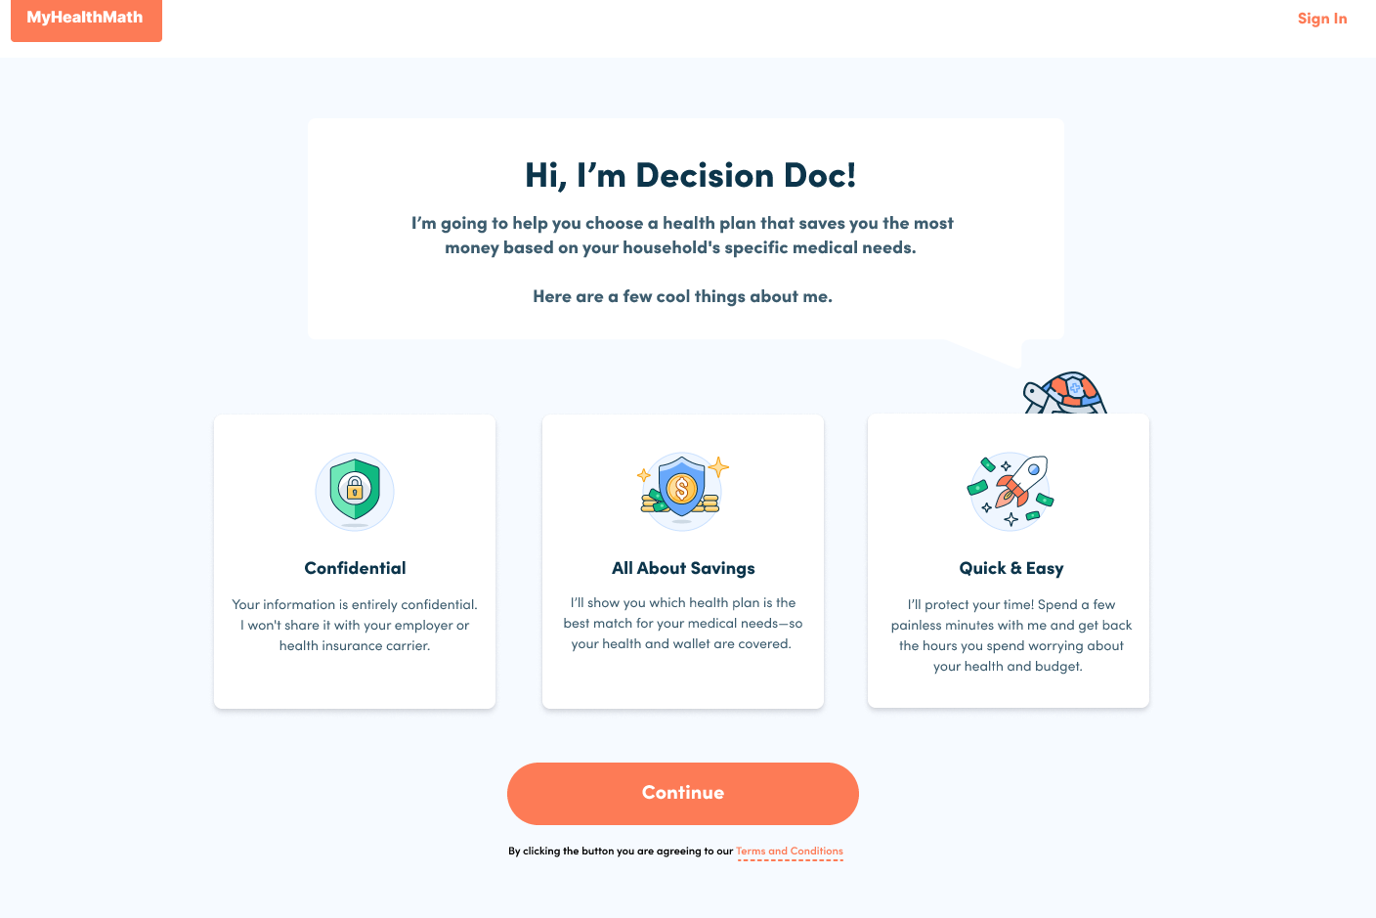
Go to Decision Doc
You’ll also receive emails and other communications with your company’s unique link: www.myhealthmath.com/ferrellgas2023
Notes:
How it works: once OE begins, you’ll be able to visit Decision Doc at www.myhealthmath.com/xxx
Here’s a reminder that everything you share is completely confidential, and at the end of the experience you’ll see which health plan is the best match for your medical needs.
Get started by clicking the “Continue” button

Slide 8
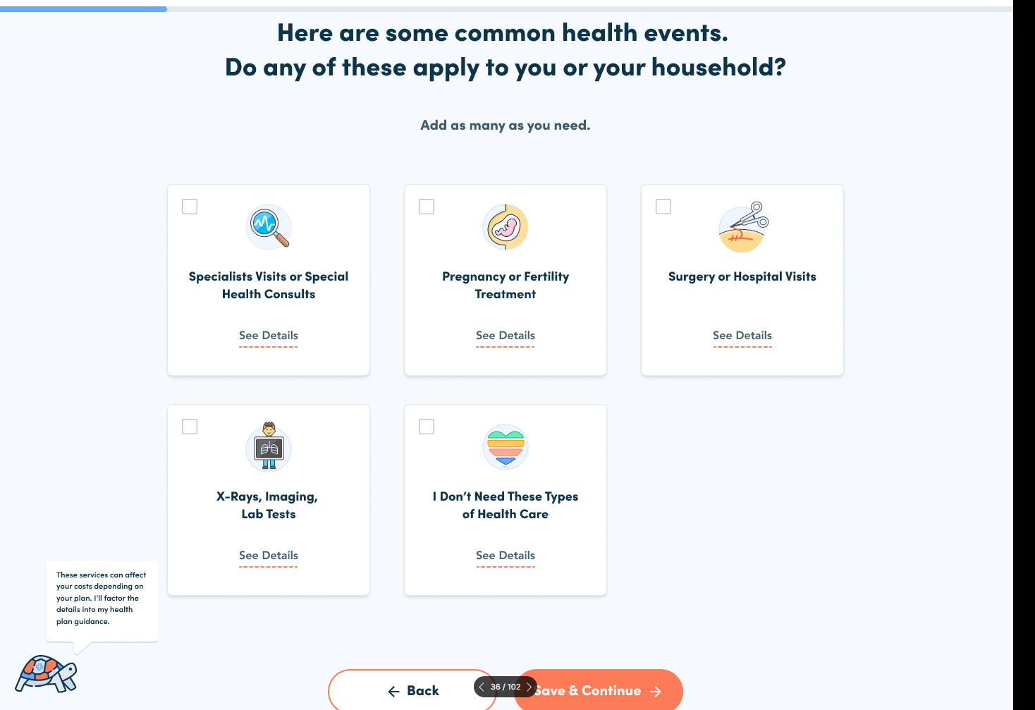
Tell us a little bit about yourself and medical and pharmacy needs.
Analysts are available to go through the questions on the phone!
Notes:
You’ll start by answering some medical questions, either online or by scheduling a phone call. Questions range from the types of specialists you and your family members may see, to surgeries you may be thinking of, to the types of prescriptions anyone may be taking. This level of detail is important so Decision Doc can calculate which plan option will best meet your specific medical needs.
If you don’t feel comfortable answering any of these questions, you can simply skip them! You’ll have the opportunity to go back and edit your responses later, if you want.

Slide 9
Receive immediate recommendations comparing your health plan options.
Contact support with any questions!
Notes:
If you answer the questions online, you’ll receive your results immediately. Decision Doc will tell you which of our health plan will be the best fit, based on cost, for you and your family. Your report will include details on how Decision Doc determines your winning plan, as well as provide a bunch of resources to help you make your decision.
Again, you’ll be able to edit your responses to see how different medical scenarios will change your costs.
If you do decide to go through the questions over the phone with a MyHealthMath agent, you will receive your report via email within 1 – 2 business days.
At any time, we encourage you to connect with MyHealthMath if you have any questions about how to use Decision Doc or how to understand your report. They can be reached via questions@myhealthmath.com, or by scheduling a phone call directly through Decision Doc.

Slide 10
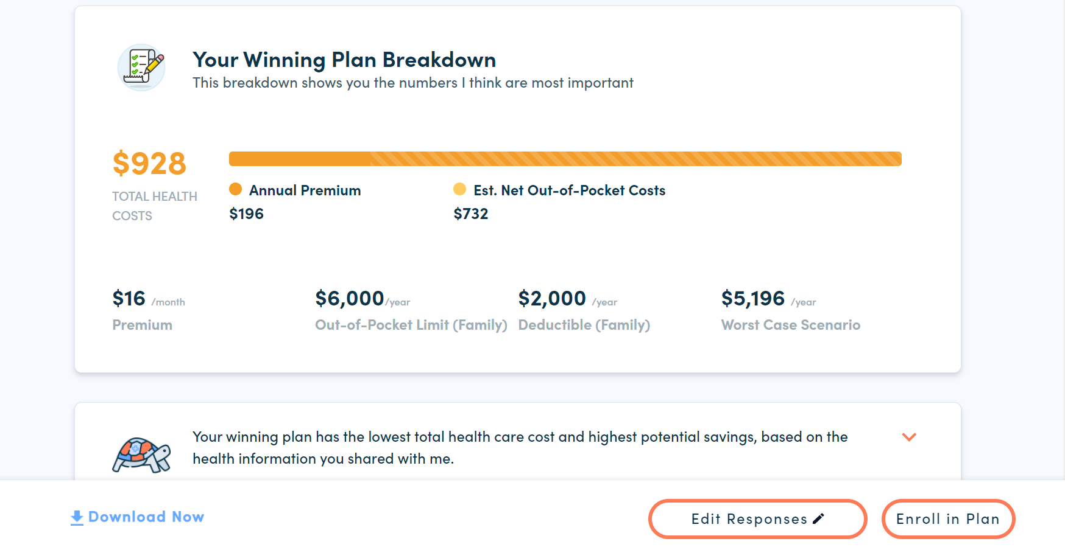
Enroll in plan and save
Employees who use MyHealthMath save over $1,300 on average.
Notes:
Keep in mind that by using Decision Doc, you are not enrolling in a health plan! So, once you determine which plan will work best for you, you’ll complete your enrollment separately.
We’re really excited to be providing you with this platform. We want to make sure everyone feels comfortable with their enrollment decisions this year, and we hope you find Decision Doc to be a valuable resource!

