Slide 1
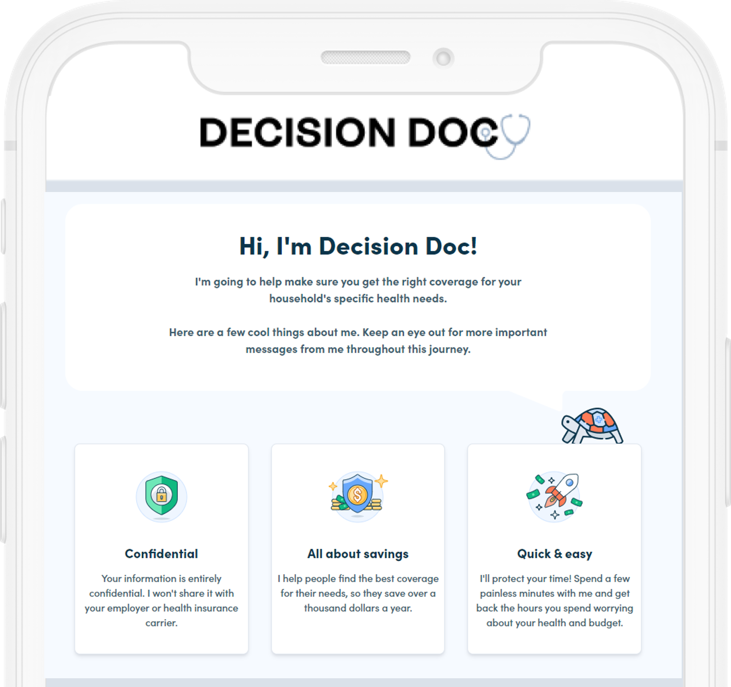



Decision Doc
Decision Doc
Helps you choose the right health plan for you and your family.
Why Use Decision Doc?
~$1,300 savings per employee
5-10 minutes to complete
All information is secure and confidential
Notes:
We’re pleased to share that Decision Doc, powered by HYKE is available to all employees. HYKE is a completely neutral third party and their interactive platform helps you learn about our health plan options before making your enrollment decision
This is a free, quick, and easy confidential service that we encourage everyone to use. It can provide peace of mind for those of you that already know which plan you want to select. Alternatively, if you aren’t sure which plan you’re going to choose, Decision Doc can help you decide. Employees who use Decision Doc save an average of $1,300 per year!

Slide 2

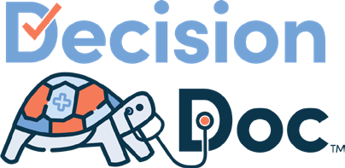
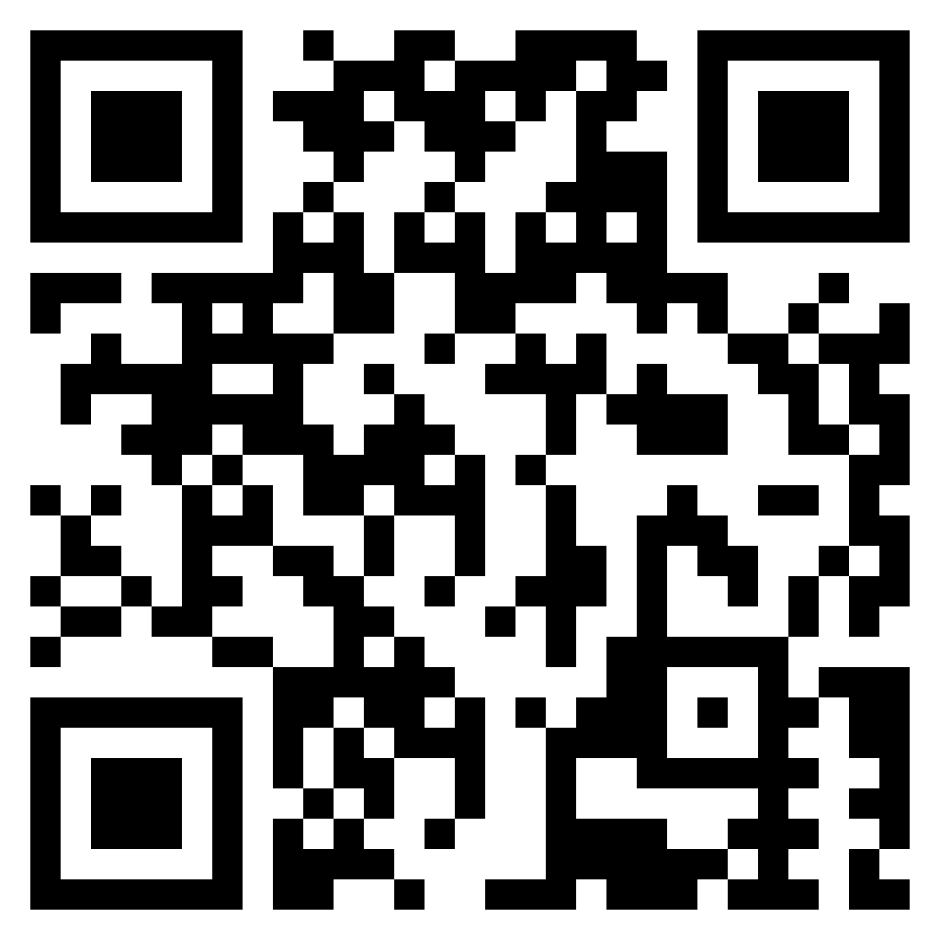
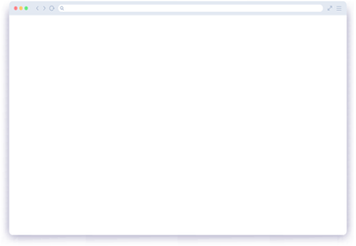
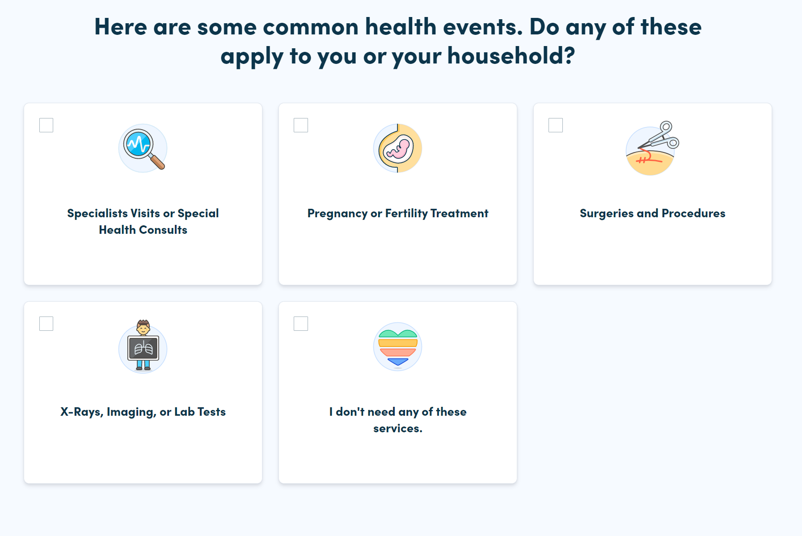
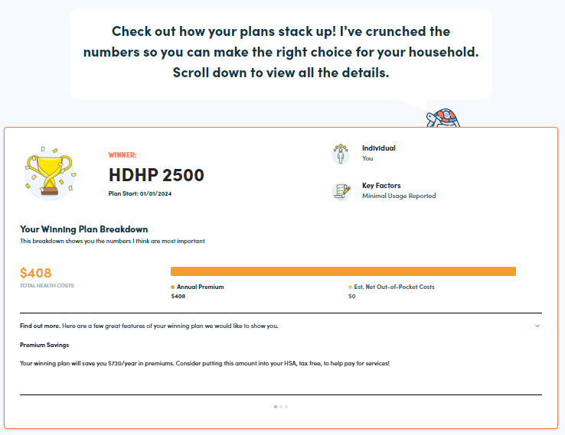
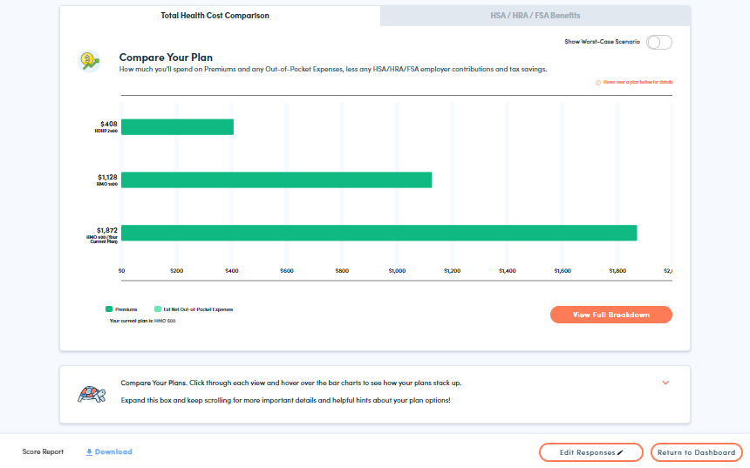
Get Started Today
Choosing the right coverage is complicated. Make it easy with Decision Doc — full coverage, digital guidance.
Access Decision Doc here:
www.myhyke.com/heidrick2024
How it works
1
Share your medical and pharmacy needs in ~5 minutes
2
Receive personalized guidance on optimal plan
3
Enroll & save!
HMO 250
Start Enrollment
Notes:
Decision Doc can be accessed using the link above, or by scanning the QR code.
You’ll start by answering some medical questions, either online or by scheduling a phone call. Questions range from the types of specialists you and your family members may see, to surgeries you may be thinking of, to the types of prescriptions anyone may be taking. This level of detail is important so Decision Doc can calculate which plan option will best meet your specific medical needs.
You then will receive immediate guidance on which plan will be the best fit, based on cost, for you and your family. Your report will include details on how Decision Doc determines your winning plan, as well as provide a bunch of resources to help you make your decision.
Once you’re ready, navigate to our enrollment system to complete your enrollment for this year.
At any time, please connect with the HYKE team if you have any questions about how to use Decision. They can be reached via questions@letshyke.com.

Slide 3
TWO chances to win BIG
$5,000 & $10,000 Sweepstakes* Opportunity
All employees who use Decision Doc during Open Enrollment will automatically be entered into a $5,000 and $10,000 Sweepstakes.
Access Decision Doc here:
www.myhyke.com/heidrick2024
Questions? Email HYKE: questions@letshyke.com
* NO PURCHASE NECESSARY. MUST BE RESIDENT OF THE UNITED STATES OR DISTRICT OF COLUMBIA, 18 OR OLDER. VOID WHERE PROHIBITED. USE DECISION DOC TO ENTER. BEGINS AT 8 AM CST ON AUGUST 1, 2023 AND ENDS AT 11 PM CST ON DECEMBER 31, 2023. PRIZE: ONE (1) $5,000 CASH PRIZE. ONE (1) $10,000 CASH PRIZE. ADDITIONAL TERMS APPLY. FOR MORE DETAILS INCLUDING ALTERNATIVE METHOD OF ENTRY SEE OFFICIAL RULES AT WWW.LETSHYKE.COM/SWEEPSTAKES-OFFICIAL-RULES-5K-JANUARY2024 & WWW.LETSHYKE.COM/SWEEPSTAKES-OFFICIAL-RULES-10K-JANUARY2024 SPONSOR: HYKE
Notes:
As an added bonus, all employees who use Decision Doc will be entered into a $5,000 sweepstakes opportunity.
All you have to do is use Decision Doc to make an informed decision when selecting your health plan.
The team at HYKE is managing this sweepstakes opportunity, so please reach out to them with any questions!

