Slide 1
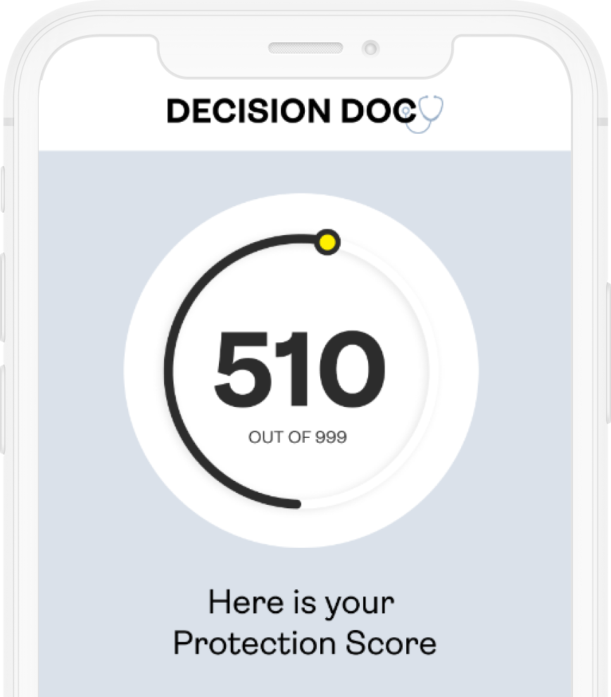

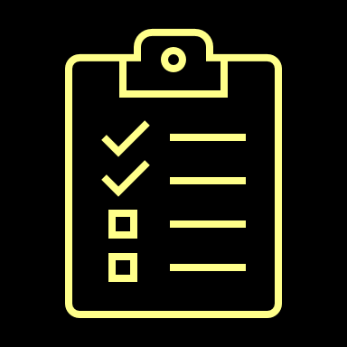

Brought to you by HYKE
Decision Doc
The Protection Score
A simple number from 1 to 999, shows how well protected you and your family are for the things that matter most.
Get personalized insights and actionable guidance, prioritized by importance, both now and over time as your life changes. HYKE helps you take control of your insurance and benefits journey.
Why Use Decision Doc?
~$1,300 savings per employee
5-10 minutes to complete
All information is secure and confidential
Notes:
We’re pleased to share that Decision Doc, powered by HYKE is available to all employees. HYKE is a completely neutral third party and their interactive platform provides you with a Protection Score to measure your health and financial wellness.
Your personalized Protection Score is a number from 1 – 999 and will be paired with personalized insights and actionable guidance, prioritized by importance to help you select a benefit package.
Why use Decision Doc? This is a free, quick, and confidential service. Employees who use Decision Doc save an average of $1,300 per year!

Slide 2
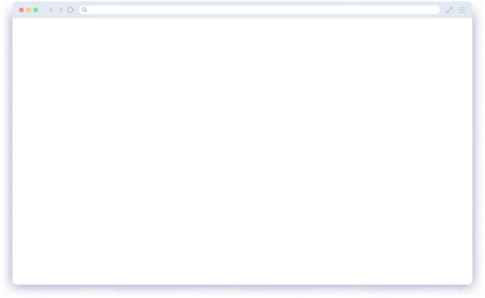
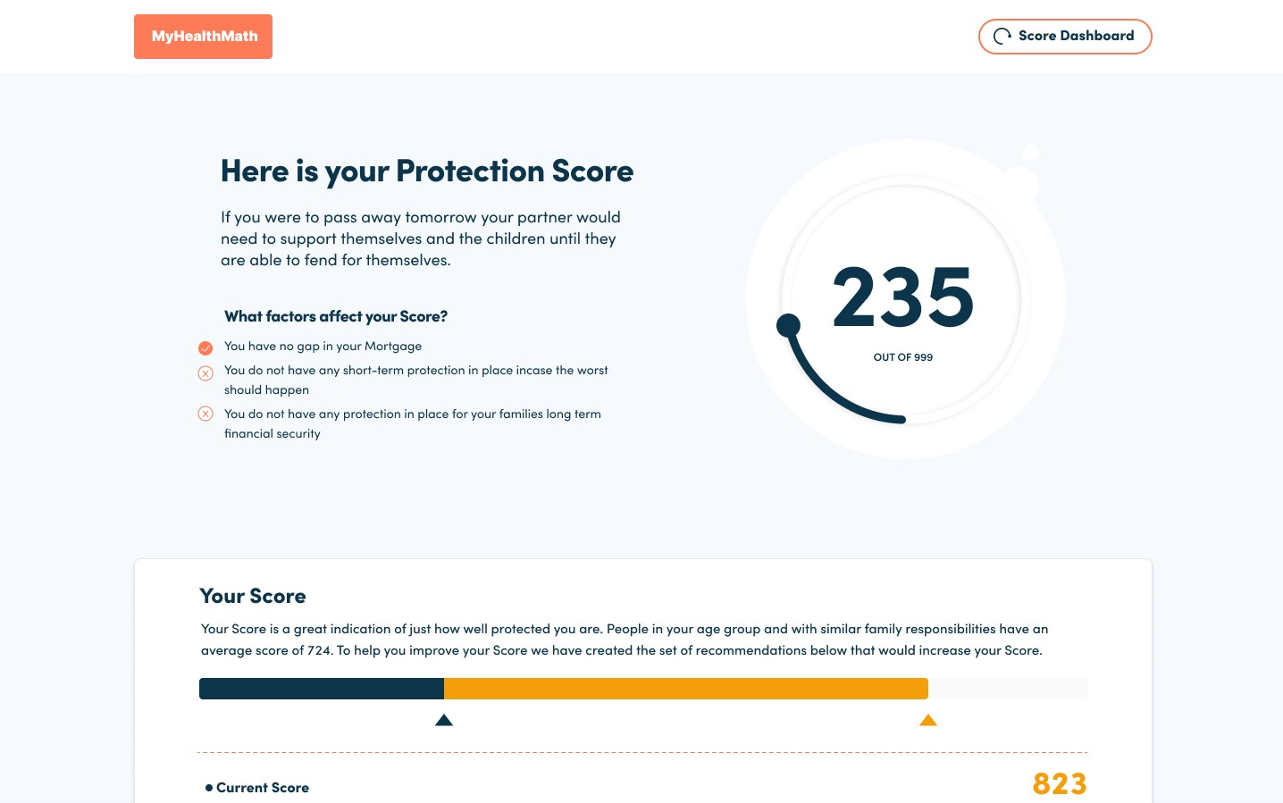
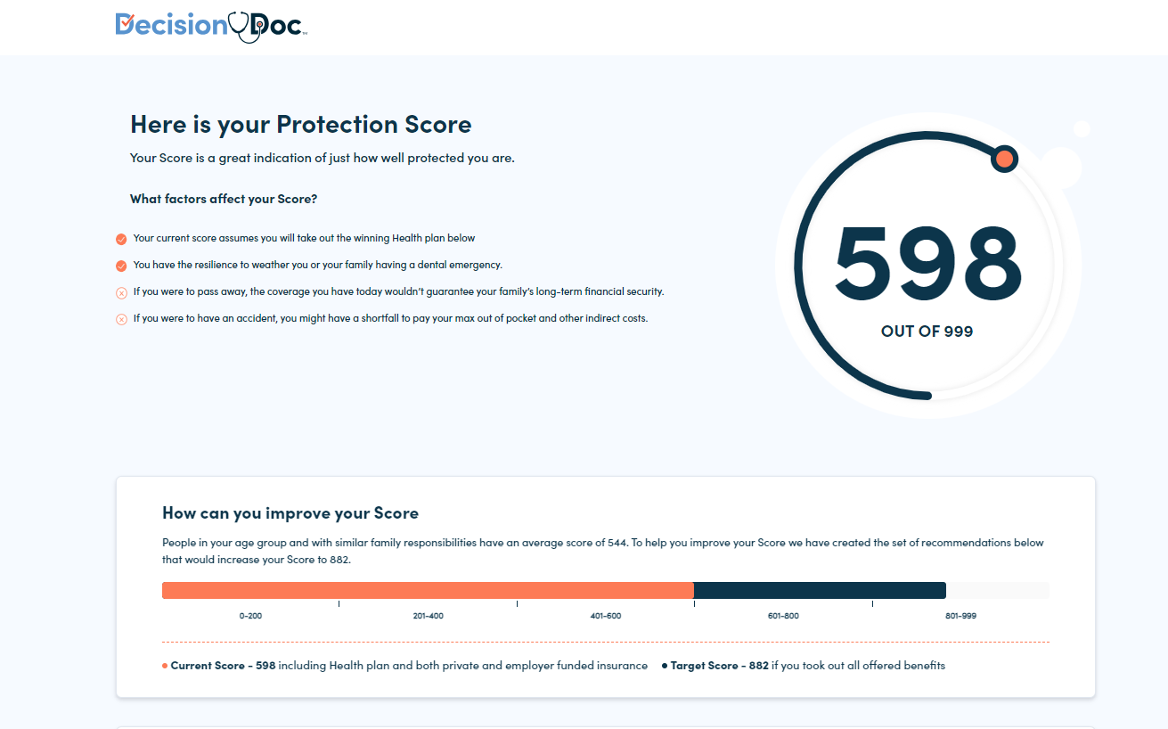

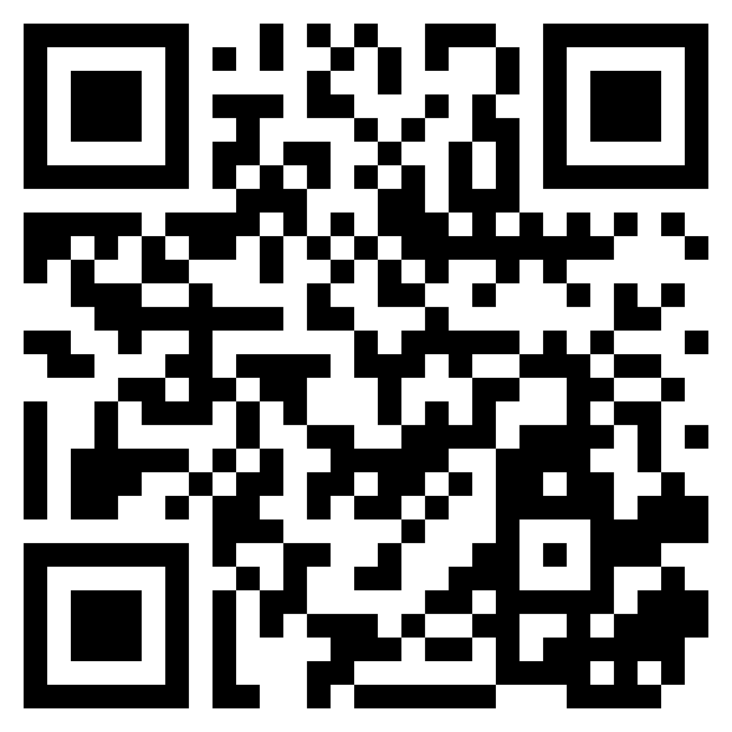
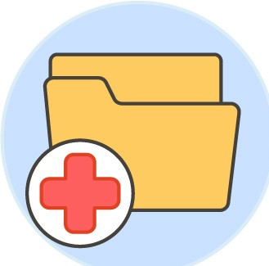


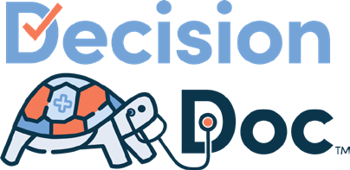



Get Started Today
Choosing the right benefits is complicated. Make it easy with Decision Doc — full coverage, digital guidance.
Access Decision Doc here:
www.myhyke.com/point32health2024
How it works
View your Claims Snapshots. Some employees can see which of their health plan options will save them the most money this upcoming year.
Score evolves as life changes. Chart progress over time.
Get a Protection Score between 0-999.
Get protection for things that matter most, today and for the future.
Use personalized guidance to choose benefits and improve score.
Answer questions about upcoming healthcare needs, finances, and family.
Notes:
Get started with Decision Doc by using the link above, or by scanning the QR code.
If you were enrolled in your one of our health plans last year, you’ll see the option to view your Claims Snapshot.
If you’re interested in viewing this snapshot, be prepared to enter your subscriber ID, which is the unique ID on your health insurance card! This helps ensure your claims data remains confidential and secure.
The Claims Snapshot will rank our current health plans based on your past medical claims’ history. This is a quick way for you to assess your options.
If you don’t think your health needs will change next year, you can head over to our enrollment platform and make your selection. However, to receive your full Protection Score, you’ll want to continue on through Decision Doc.
All employees will answer some questions about healthcare needs, finances and family. You can answer these questions online or by scheduling a phone call.
You will be able to save and edit your responses later, so take your best guess when going through the questions for the first time.
When you’re done, you’ll receive your instant Protection Score that tells you which benefits will help you stay protected.
Once you’re ready, navigate to our enrollment system to complete your enrollment for this year.
At any time, please connect with the HYKE team if you have any questions about how to use Decision. They can be reached via questions@letshyke.com.

