Slide 1
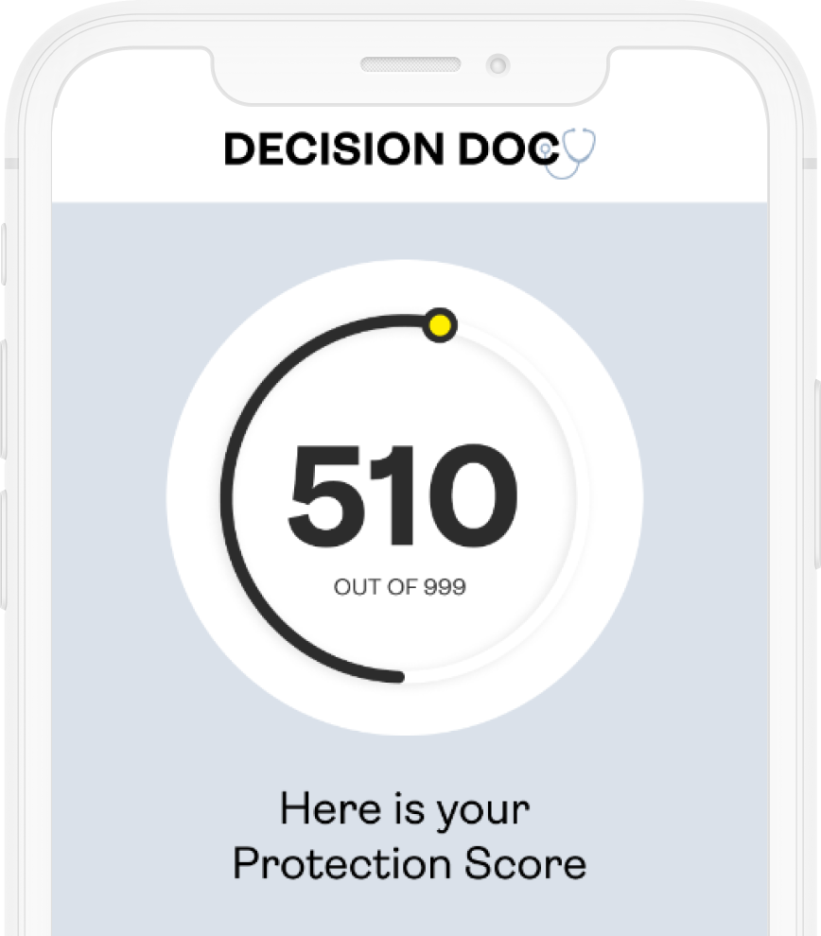





The Protection Score
A simple number from 1 to 999, shows how well protected you and your family are for the things that matter most.
Get personalized insights and actionable guidance, prioritized by importance, both now and over time as your life changes. HYKE helps you take control of your insurance and benefits journey.
Why Use HYKE?
~$1,300 savings per employee
5-10 minutes to complete
All information is secure and confidential
Notes:
We’re pleased to share that HYKE is available to all employees. HYKE is a completely neutral third party and their interactive platform provides you with a Protection Score to measure your health and financial wellness.
Your personalized Protection Score is a number from 1 – 999 and will be paired with personalized insights and actionable guidance, prioritized by importance to help you select a benefit package.
Why use HYKE? This is a free, quick, and confidential service. Employees who use HYKE save an average of $1,300 per year!

Slide 2
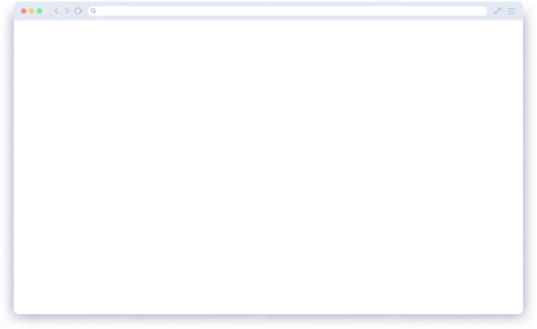
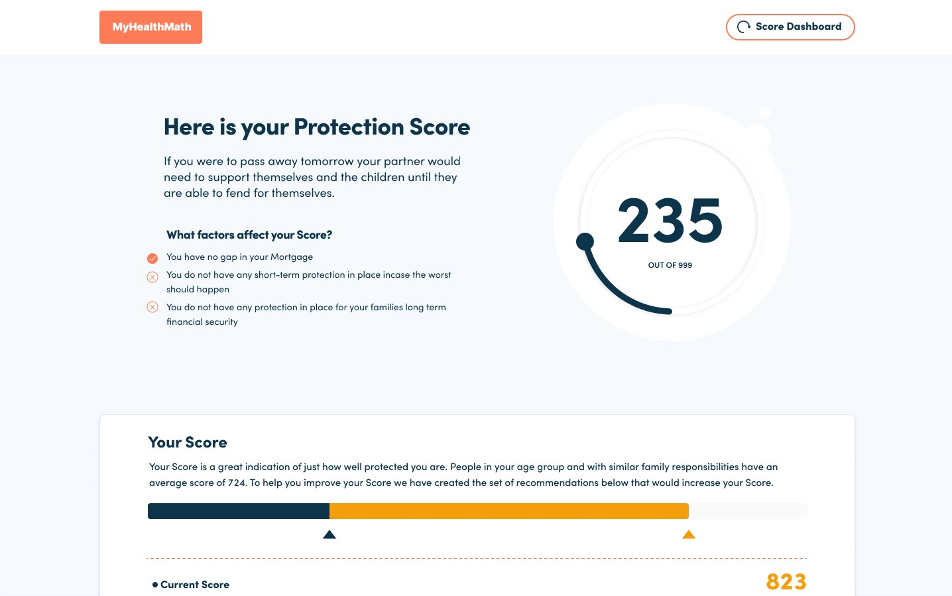
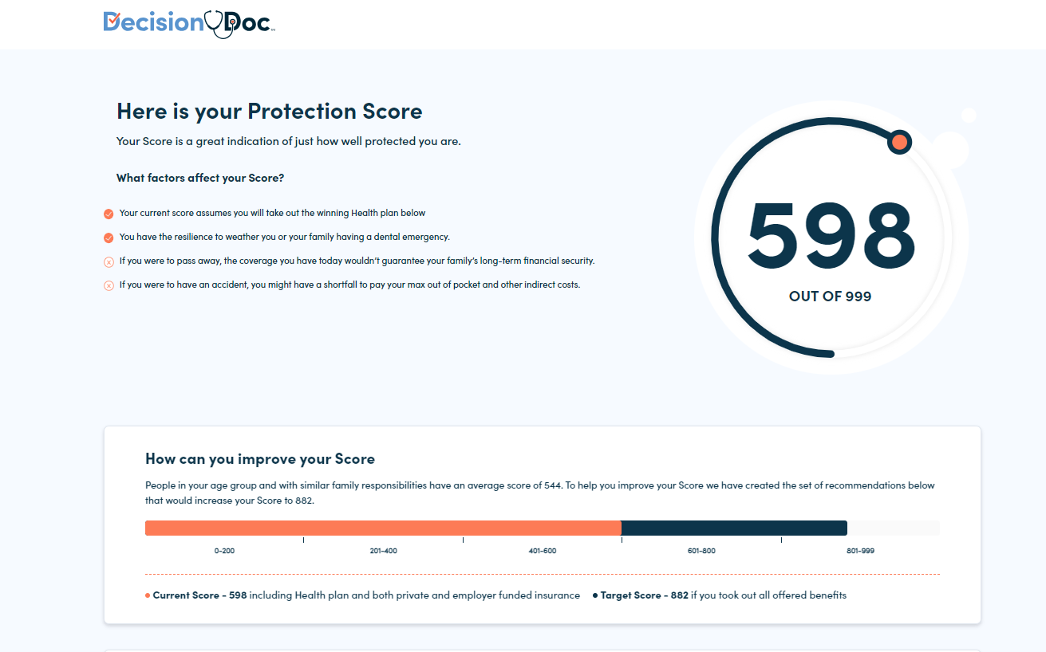

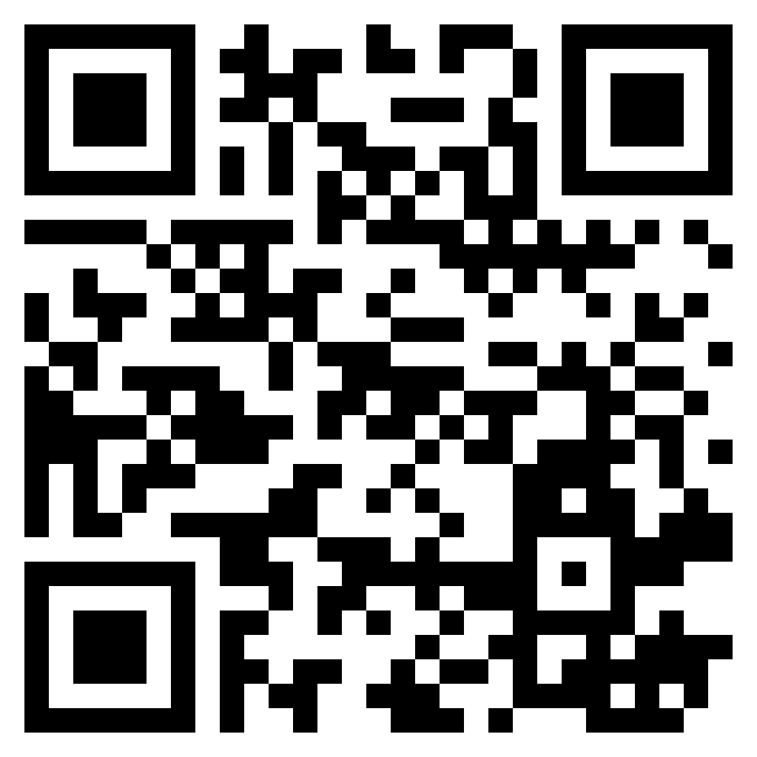





Get Started Today
Choosing the right benefits is complicated. Make it easy with HYKE— full coverage, digital guidance.
www.myhyke.com/riverstone2024
How it works
Answer questions about healthcare needs, finances, and family.
Use personalized guidance to choose benefits and improve score.
Get protection for things that matter most, today and for the future.
Get a Protection Score between 0-999.
Score evolves as life changes. Chart progress over time.
Notes:
Get started with HYKE by using the link above, or by scanning the QR code.
You’ll start by answering some questions about healthcare needs, finances and family. You can answer these questions online or by scheduling a phone call.
You will be able to save and edit your responses later, so take your best guess when going through the questions for the first time.
When you’re done, you’ll receive your instant Protection Score that tells you which benefits will help you stay protected.
Once you’re ready, navigate to our enrollment system to complete your enrollment for this year.
At any time, please connect with the HYKE team if you have any questions about how to use the decision support tool. They can be reached via questions@letshyke.com.

