Slide 1
Personalized Decision Support
Decision Doc, powered by Sherpa Score, helps you choose the benefit package for you and your family.

Slide 2
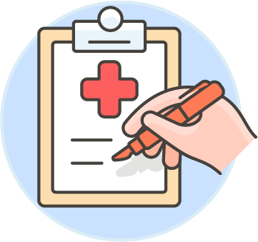
Why Use Decision Doc:
~$1,300 savings per employee
10 - 12 minutes to complete
All information is secure and confidential
Notes:
As an added benefit to you, we’re pleased to share that Decision Doc, powered by Sherpa Score, is available to all employees. They are a completely neutral third party and their interactive platform can help you learn about our benefit options before making your enrollment decision.
This is a free, quick, and easy confidential service that we encourage everyone to use. It can provide peace of mind for those of you that already know which benefits you want to select. Alternatively, if you aren’t sure which plans you’re going to choose, Decision Doc can help you decide!

Slide 3
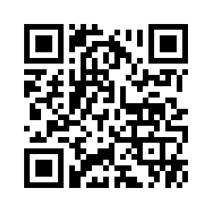
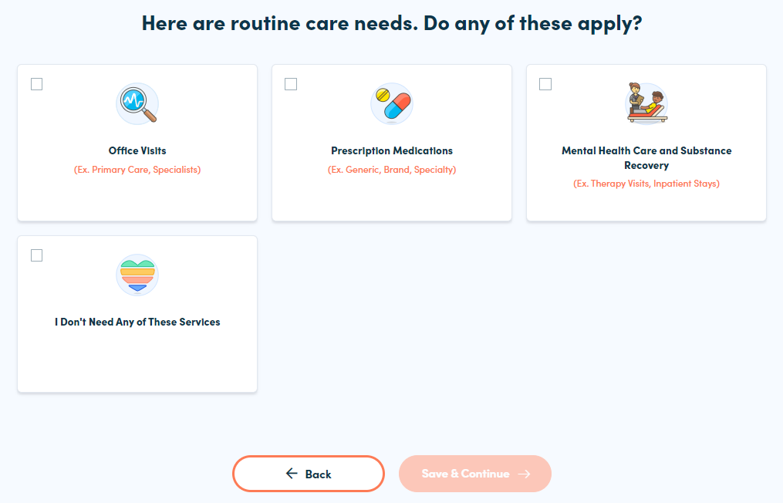
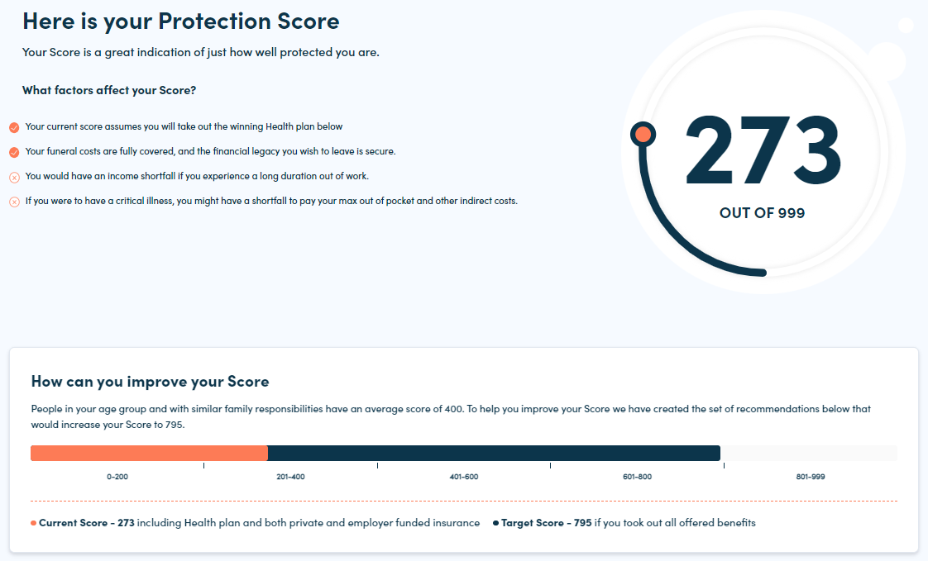
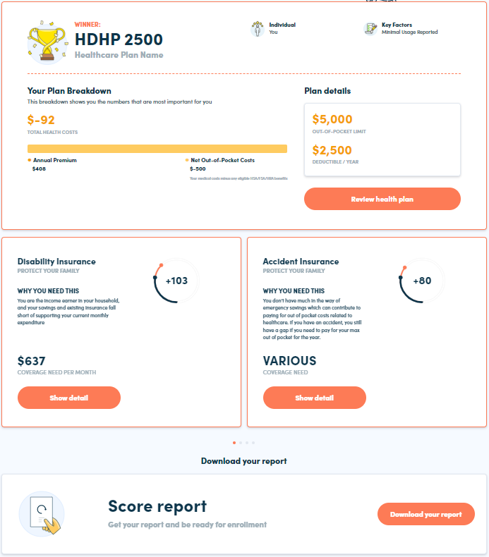
How It Works
Access Decision Doc here: www.myhealthmath.com/therkgroup2023
Answer questions about your health care needs, finances and family.
It takes just 10 – 12 minutes!
Receive an immediate Protection Score with guidance on how you may improve your score.
Click through each module to learn about your benefit options! When you’re ready, download your report and then enroll in your benefit package.
1
2
3
Notes:
Decision Doc can be accessed using the link above, or by scanning the QR code.
You’ll start by answering some questions about your upcoming health care needs, finances and family situation. Questions range from the types of specialists you and your family members may see, to surgeries you may be thinking of, to your current housing situation and estimated monthly expenses. This level of detail is important so Decision Doc can calculate which benefits will best protect you and your family.
You’ll answer these questions online and will receive an immediate Protection Score, which is an indicator of how well protected you are. Your dashboard will include details on how Decision Doc determined your winning health plan, as well as clickable modules to learn more about your additional benefit options.
At any time, if you have questions about how to use Decision Doc or about how Decision Doc identified your winning health plan, please reach out to the MyHealthMath Team. They can be reached via questions@myhealthmath.com.

