Slide 1

Personalized Decision Support
Decision Doc helps you choose the right health plan for you and your family.

Slide 2

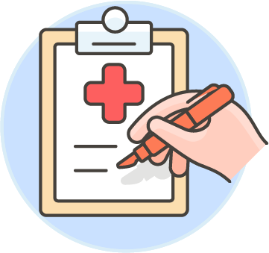

Why Use Decision Doc:
~$1,300 savings per employee
5-10 minutes to complete
All information is secure and confidential
Notes:
As an added benefit to you, we’re pleased to share that Decision Doc, powered by MyHealthMath, is available to all employees. MyHealthMath is a completely neutral third party and their interactive platform can help you learn about our health plan options before making your enrollment decision.
This is a free, quick, and easy confidential service that we encourage everyone to use. It can provide peace of mind for those of you that already know which plan you want to select. Alternatively, if you aren’t sure which plan you’re going to choose, Decision Doc can help you decide!

Slide 3
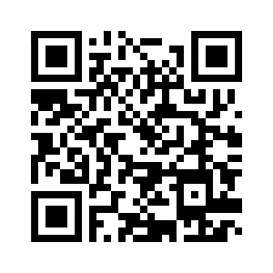
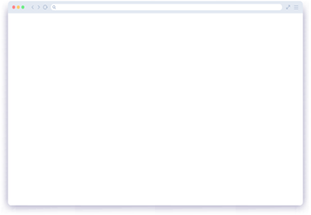
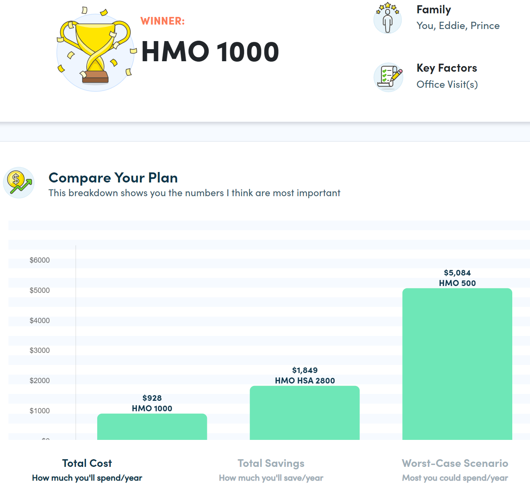
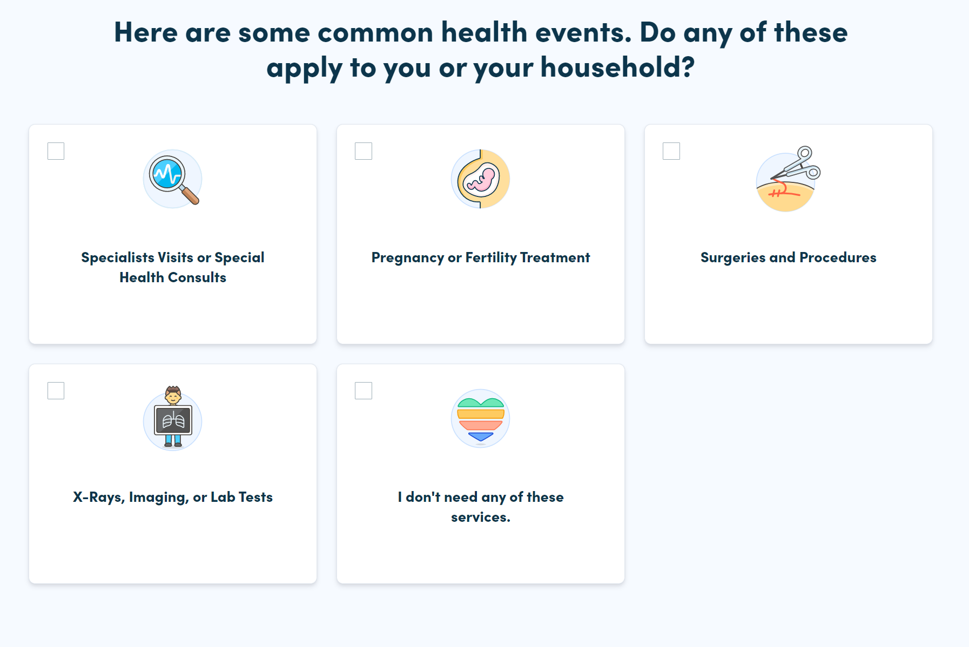
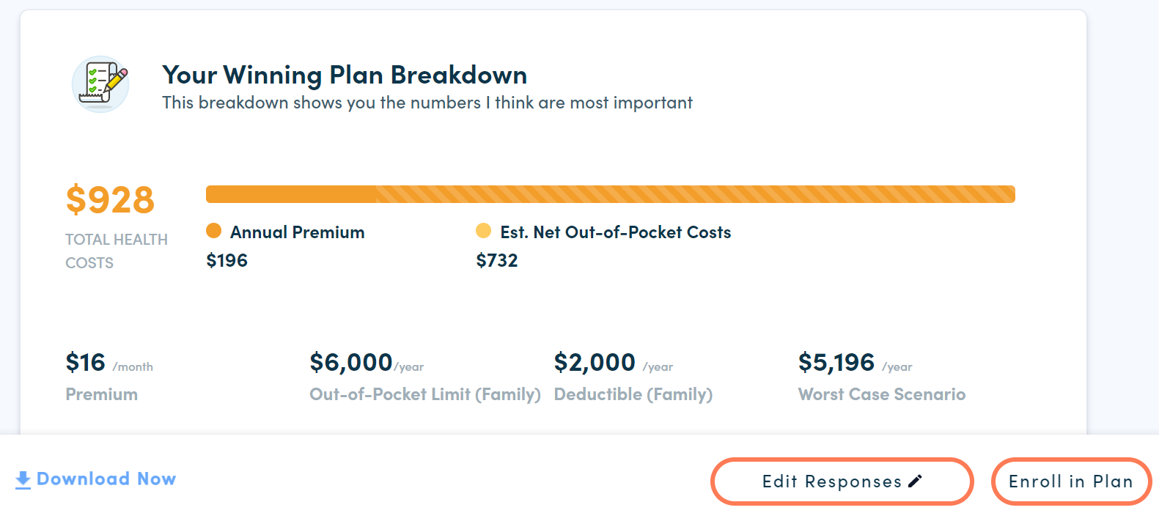
How It Works
Access Decision Doc here: www.myhealthmath.com/vertiv2023
Share your medical and pharmacy needs in ~5 minutes
Agents available to go through the questions on the phone!
Receive immediate recommendations on optimal plan
Contact support with any questions!
Enroll & Save
Average employee user saves $1,300/year
1
2
3
Notes:
Decision Doc can be accessed using the link above, or by scanning the QR code.
You’ll start by answering some medical questions, either online or by scheduling a phone call. Questions range from the types of specialists you and your family members may see, to surgeries you may be thinking of, to the types of prescriptions anyone may be taking. This level of detail is important so Decision Doc can calculate which plan option will best meet your specific medical needs.
If you answer these questions online, you’ll receive an immediate recommendation on which plan will be the best fit, based on cost, for you and your family. Your report will include details on how Decision Doc determines your winning plan, as well as provide a bunch of resources to help you make your decision.
If you do decide to go through the questions over the phone with a MyHealthMath agent, you will receive your report via email within 1 – 2 business days.
At any time, we encourage you to connect with MyHealthMath if you have any questions about how to use Decision Doc or how to understand your report. They can be reached via questions@myhealthmath.com.

