Slide 1
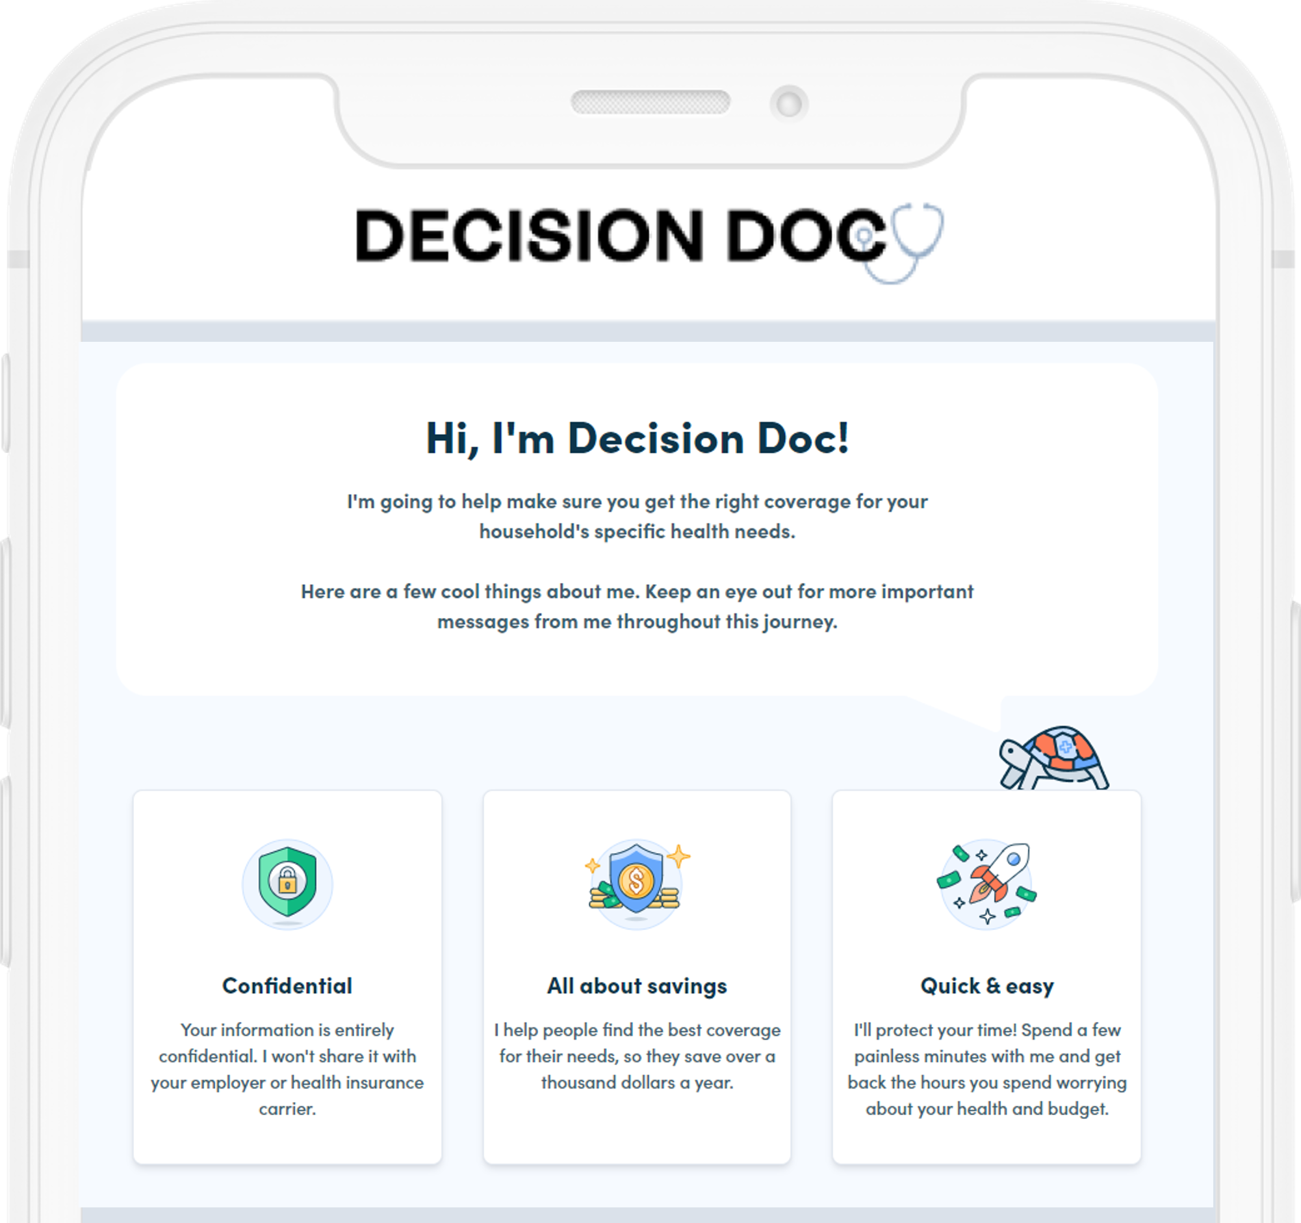



Decision Doc
Decision Doc
Helps you choose the right health plan for you and your family.
Why Use Decision Doc?
~$1,30 savings per employee
5-10 minutes to complete
All information is secure and confidential
Notes:
We’re pleased to share that Decision Doc, powered by HYKE (formerly MyHealthMath) is available again this year, to all employees. HYKE is a completely neutral third party and their interactive platform helps you learn about our health plan options before making your enrollment decision
This is a free, quick, and easy confidential service that we encourage everyone to use. It can provide peace of mind for those of you that already know which plan you want to select. Alternatively, if you aren’t sure which plan you’re going to choose, Decision Doc can help you decide. Employees who use Decision Doc save an average of $1,300 per year!

Slide 2
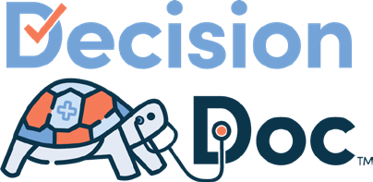

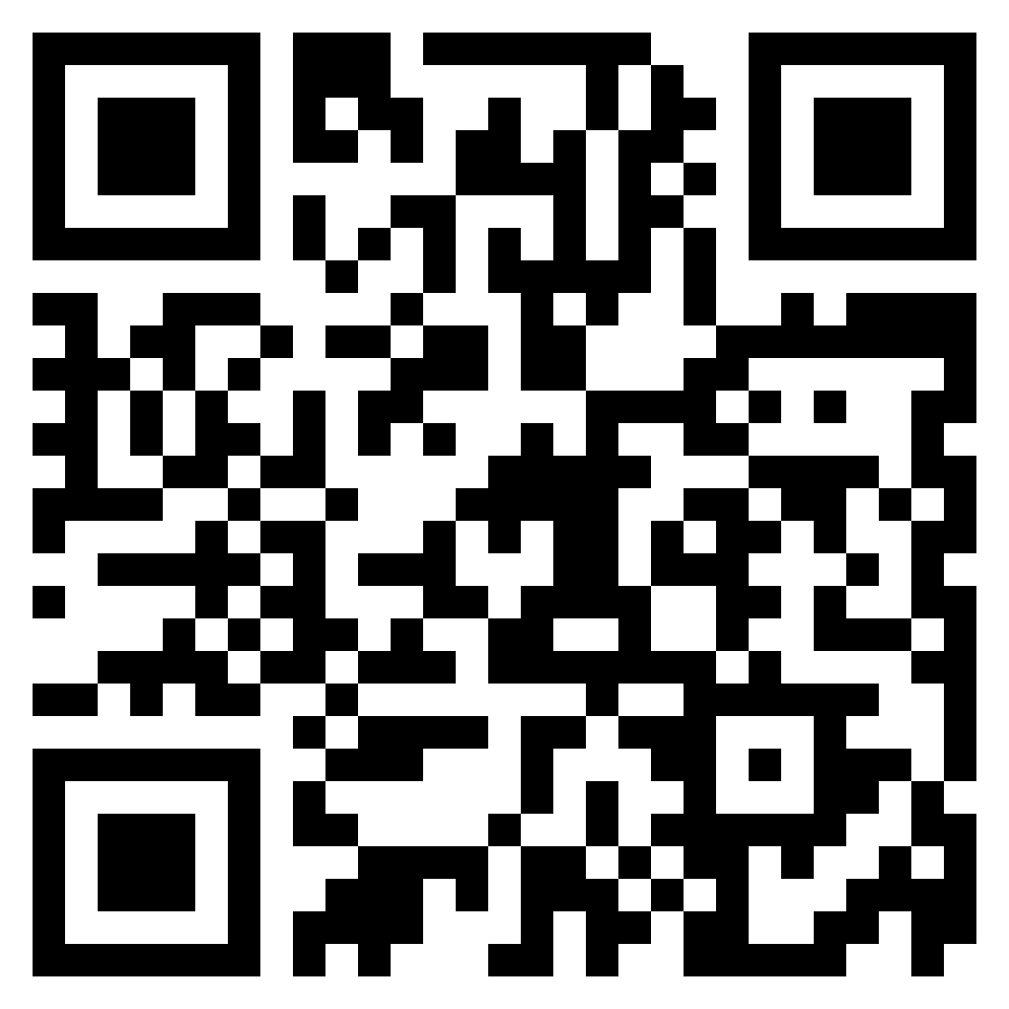

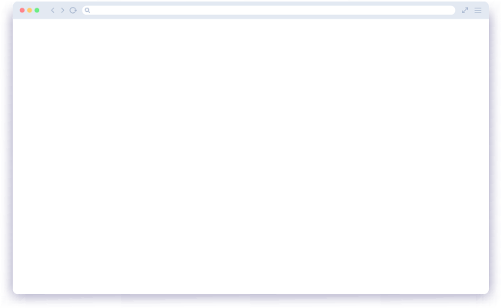
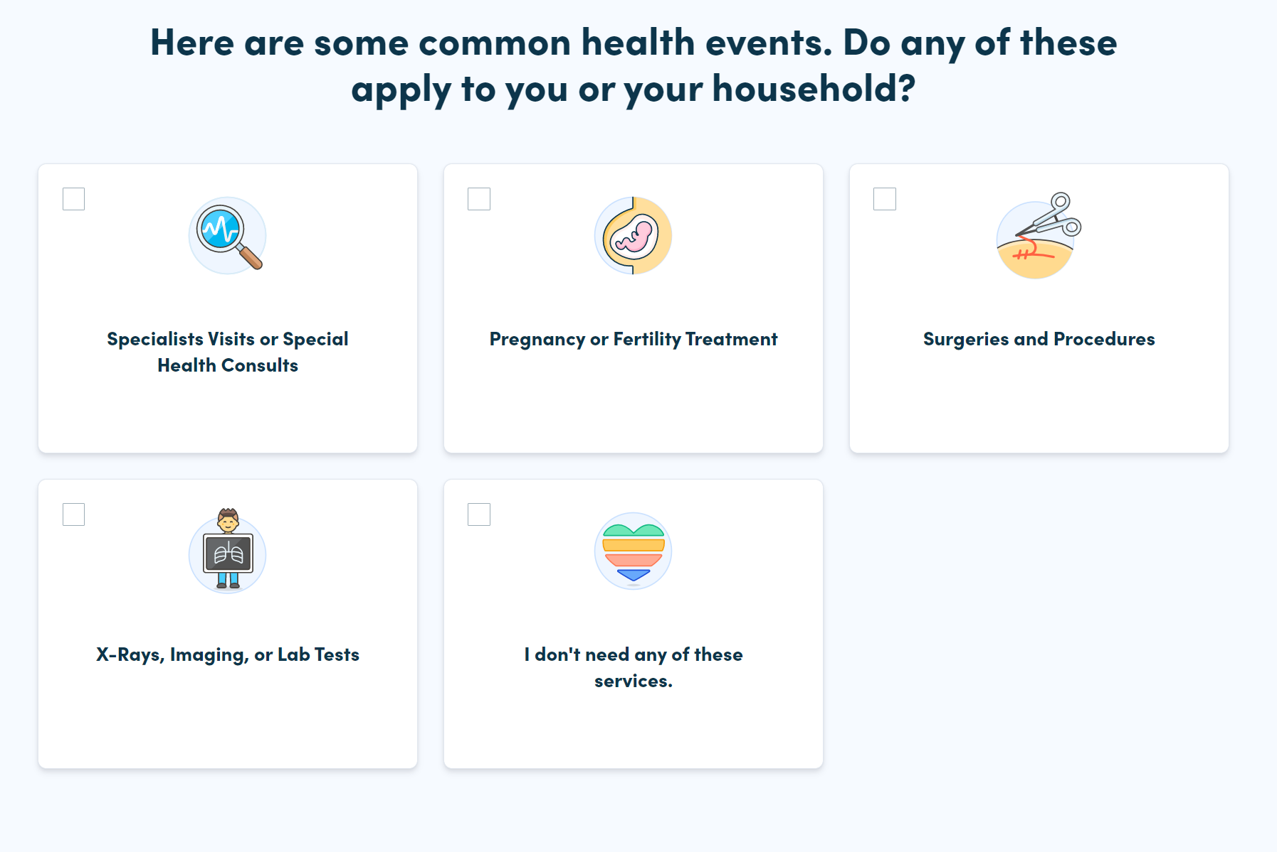
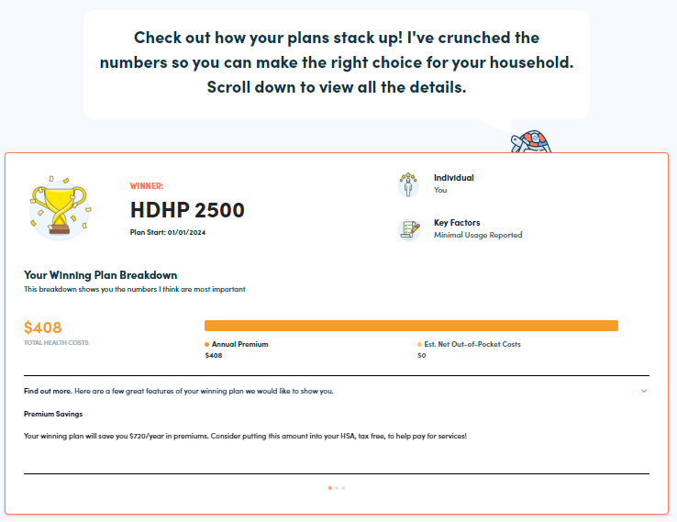
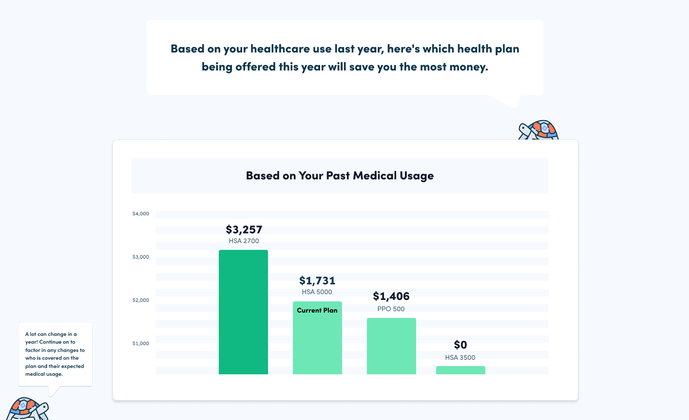
Get Started Today
Choosing the right coverage is complicated. Make it easy with Decision Doc — full coverage, digital guidance.
Access Decision Doc here:
www.myhyke.com/nashobalearninggroup2024
How it works
1
View your Claims Snapshot. Some employees may see an option to view a Claims snapshot, which compares your health plan options based on your past health care usage (your claims).
2
Answer some questions. Answer questions (online or over the phone) about your upcoming medical and pharmacy needs.
3
Receive an instant report showing which plan will save you the most money. Save this report and used it to make an informed health plan selection!
HMO 250
Notes:
Decision Doc can be accessed using the link above, or by scanning the QR code.
Once you reach the platform, you may see an option to view a Claims Snapshot. This feature is available to employees who have been enrolled in one of our health plans. To unlock your Snapshot, you’ll need to enter your subscriber ID, the unique ID found on your health insurance card. Once you enter your ID, Decision Doc will show you which plan will save you the most money, based on your medical and pharmacy usage last year. Claims snapshots can help you make a quick decision about our plans if your health needs for the upcoming year aren’t changing.
Importantly, since health needs do often change, we strongly recommend all employees continue on to step 2 to see an updated report.
In Step 2, you’ll start by answering some medical questions, either online or by scheduling a phone call. Questions range from the types of specialists you and your family members may see, to surgeries you may be thinking of, to the types of prescriptions anyone may be taking. This level of detail is important so Decision Doc can calculate which plan option will best meet your specific medical needs.
You then will receive immediate guidance on which plan will be the best fit, based on cost, for you and your family. Your report will include details on how Decision Doc determines your winning plan, as well as provide a bunch of resources to help you make your decision.
Once you’re ready, navigate to our enrollment platform to complete your enrollment for this year.
At any time, please connect with the HYKE team if you have any questions about how to use Decision. They can be reached via questions@letshyke.com.

Slide 3
A chance to win BIG
$5,000 Sweepstakes* Opportunity
All employees who use Decision Doc during Open Enrollment will automatically be entered into a $5,000 Sweepstakes.
Access Decision Doc here:
www.myhyke.com/nashobalearninggroup2024
Questions? Email HYKE: questions@letshyke.com
* NO PURCHASE NECESSARY. MUST BE RESIDENT OF THE UNITED STATES OR DISTRICT OF COLUMBIA, 18 OR OLDER. VOID WHERE PROHIBITED. USE DECISION DOC TO ENTER. BEGINS AT 8 AM CST ON AUGUST 1, 2023 AND ENDS AT 11 PM CST ON DECEMBER 31, 2023. PRIZE: ONE (1) $5,000 CASH PRIZE. ADDITIONAL TERMS APPLY. FOR MORE DETAILS INCLUDING ALTERNATIVE METHOD OF ENTRY SEE OFFICIAL RULES AT WWW.LETSHYKE.COM/SWEEPSTAKES-OFFICIAL-RULES-5K-JANUARY2024. SPONSOR: HYKE
Notes:
As an added bonus, all employees who use Decision Doc will be entered into a $5,000 sweepstakes opportunity.
All you have to do is use Decision Doc to make an informed decision when selecting your health plan.
The team at HYKE is managing this sweepstakes opportunity, so please reach out to them with any questions!

